Slide 1
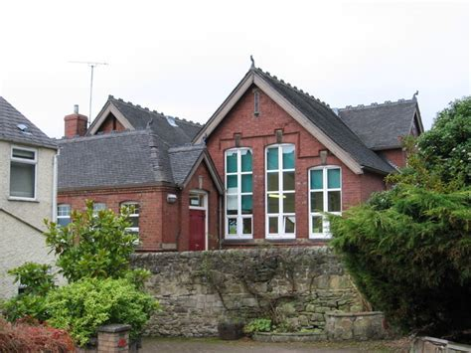
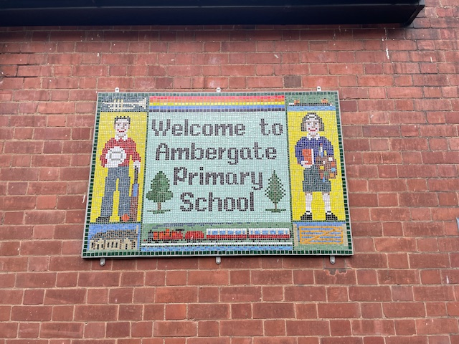

Ambergate Primary School
Sustainability Report
Spring 2025

Slide 2
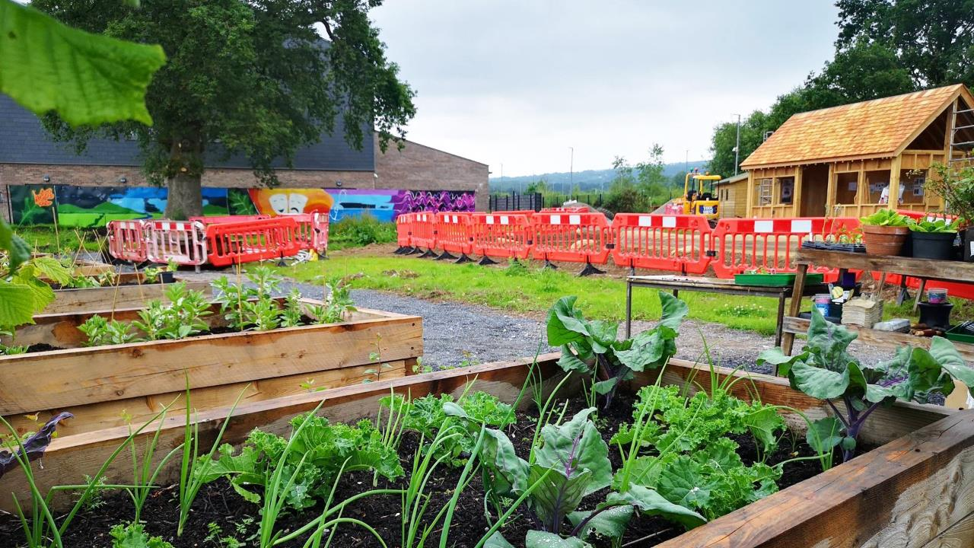

This report covers:
Your journey so far
A review of, and suggested actions, for:
  Decarbonisation
  Adaptation and Resilience
  Biodiversity
  Climate Education & Green Skills
Longlist of actions
Next steps
www.letsgozero.org
charity no: 1104153

Slide 3
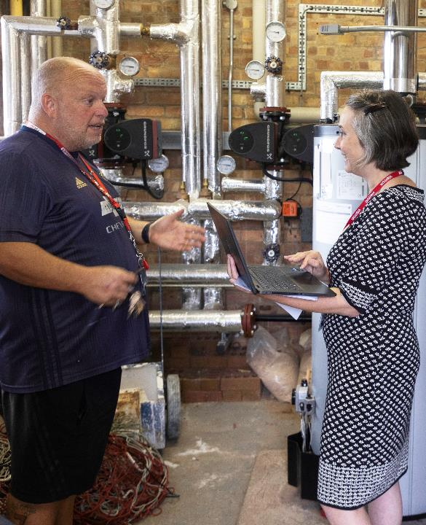
Site Visit Details
Visit date: 24th April 2025
Key staff present:
Carly Howell – Head teacher
Anne – SBM
Jordan – Site Manager
Climate Action Advisor:
Cindi Blunt

Slide 4

Your journey so far…
Outdoor learning across all year groups using community green spaces and woodland
Planting and nature projects flourishing despite restricted size of site
Ethos of caring and taking responsibility or nature and the environment is woven into reading and writing through carefully curated reading list
LEDs throughout
Use the train for trips and partner with EMR outreach
Water saving measures installed in pupil toilets
Food waste and recycling collections underway
Reuse of uniform and dress-up clothes established

Slide 5
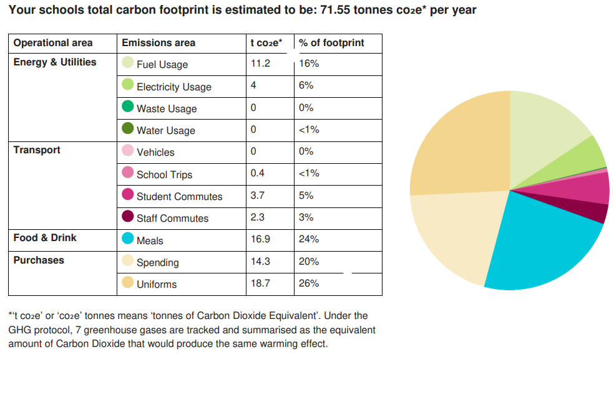

Ambergate Primary’s Count Your Carbon Score
Notes:
EXAMPLE GRAPHIC - Insert school's total emissions graphic from their CYC report

Slide 6
How your footprint per pupil compares…
Tonnes of CO2 per pupil per year.
Data taken from Count Your Carbon scores of schools engaging with the Climate Action Advisors
Notes:
Don't include this if schools are doing better than average in every category – only if they have room for improvement

Slide 7

How your footprint compares…
Your carbon footprint is the same as each pupil taking 11 flights to Paris and back every year
Notes:
Change picture to relevant illustration. The above is an example, but use Find out the Carbon Footprint of Common Items - clever carbon to find a relevant equivalent. Or, you can use Carbon Translator - Small99 to find out miles (One tonne is 1000kg) and figure out how many times driving around the world (circumference is 24,901.46 miles).

Slide 8
Decarbonisation & Energy Efficiency
Calculating and taking actions to reduce carbon emissions and become more energy efficient.
Pillars to be discussed:
    Energy
    Transport
    Procurement
    Food
    Waste

Slide 9
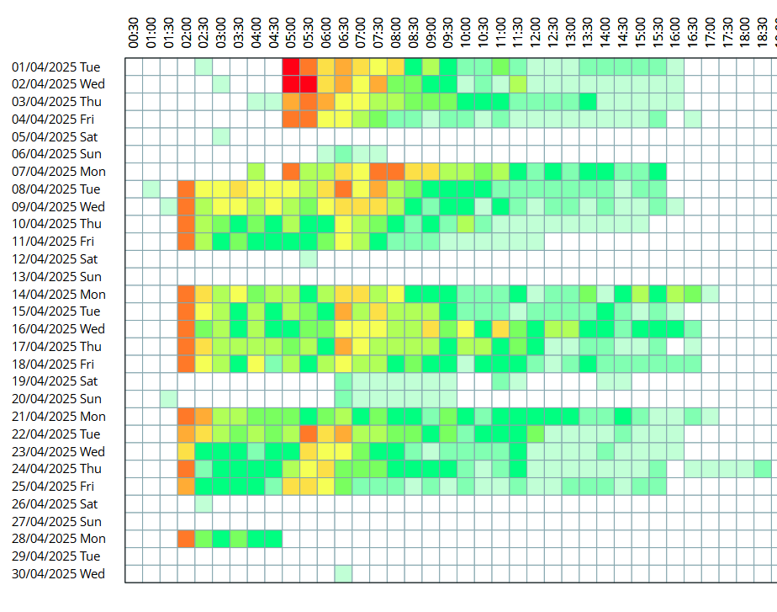
Energy
Our findings:
Completed Count Your Carbon Calculation
Double glazed and LEDs throughout
Jordan checking all appliances are off at end of day
Heating controls not accurate or operating effectively – systemslink shows gas use out of hours
Some whiteboards left on during lunch break
Suggested actions:
Consider enrolling on Energy Sparks for monitoring of gas and electricity use and create behaviour change across staff and pupils and/or use Systemslink to continually monitor
Book Fieldwell to correctly configure heating controls
Investigate the potential for solar panels (not viable through Solar for Schools) (long list)
Take part in a switch off campaign
Site Details

Slide 10
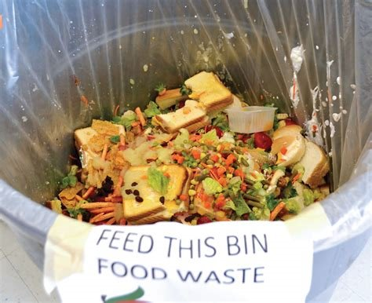
Food
Our findings:
Food prepared at nearby school and brought in
Food waste collections underway
Separate food waste bins underway for dinner hall, class and staff rooms – done
Meat free offer every day and meat free day once a week (Derbyshire Catering)
Suggested actions:
Explain reasons for eating less meat and reducing food waste during lessons, assemblies etc.
Weigh food waste from kitchen and plates and share results and educate on impact of food waste

Slide 11
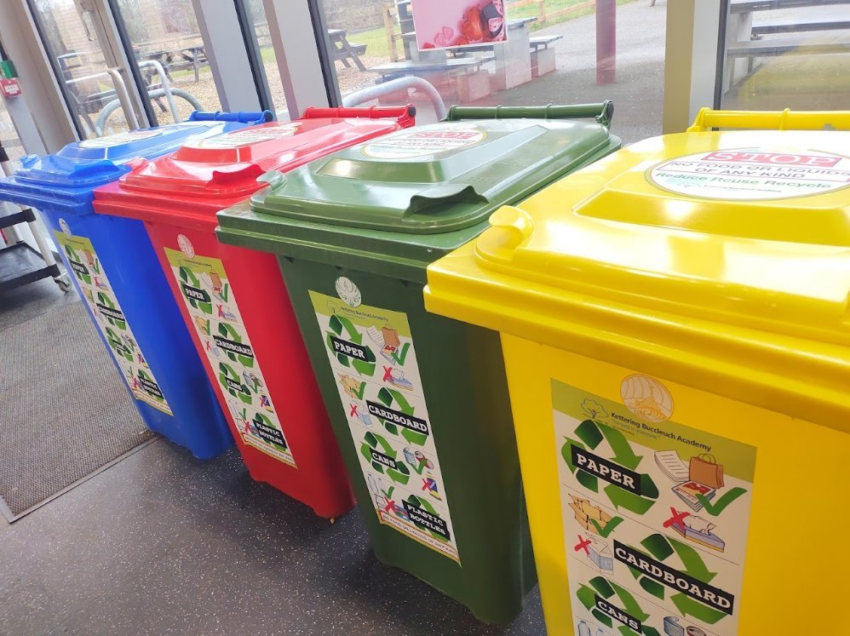
Waste
Our findings:
Increased recycling collections underway
Using reusable crockery, dessert pots, cutlery etc
Recycling collection set up and embedded – colour coded bins
Reduced size of general waste bin
Suggested actions:
Continue education around recycling as part of assemblies or other whole school opportunities (core values - be responsible, be caring)
Engage with a plastic reduction campaign resources e.g. Surfers Against Sewage

Slide 12
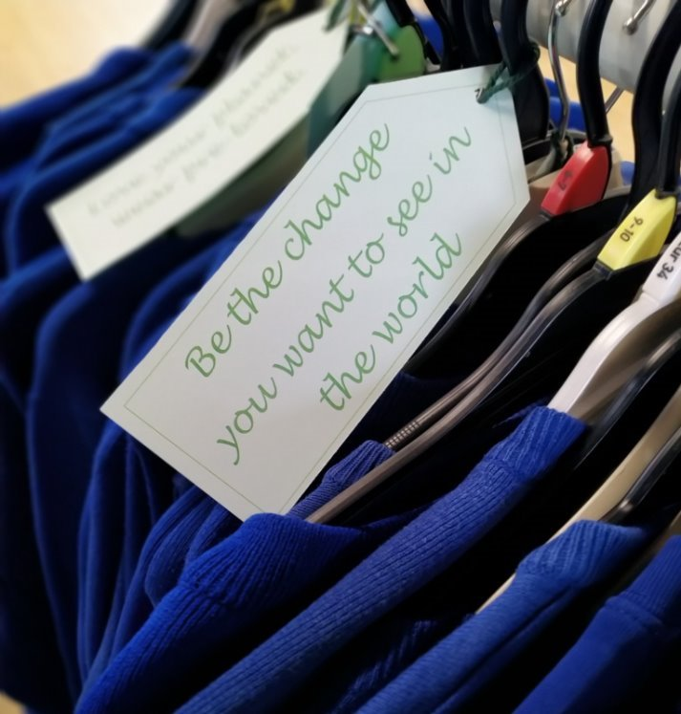

Procurement
Our findings:
Reuse of uniform and dress-up clothes established
Reduce branding on uniform and school items
Suggested actions:
Include sustainability as part of your criteria for procurement e.g. made of recycled materials, non-toxic or ethically sourced, energy efficient appliances
Switch to recycled or sustainably sourced paper – frame as a positive climate action

Slide 13

Transport
Our findings:
Conducted staff and student travel surveys – nearly 60% of pupils walk/cycle/scoot
Used train when possible for school trips
Developed an active travel plan
Promoted walking/cycling/public transport to school/ Park & Stride
Provided cycle proficiency lessons in school e.g. Bikeability
Travel Plan lapsed (2016)
Location of school very difficult for parking nearby, park and stride from eg Hurt Arms involves crossing main A6 with no crossing
Suggested actions:
Reinstate Travel Plan on Modeshift Stars – intro to Rob Bounds, DCC Sustainable Travel Officer
Park and Stride using Anila car park

Slide 14
Climate Adaptation & Resilience
Taking actions to reduce the risk of flooding and overheating and to future proof scarce resources for potential shortages.
Pillars to be discussed:
    Water
    Adaptation & Resilience

Slide 15
Adaptation and Resilience
Our findings:
Some sheltered areas on playground
Drain maintenance in place to manage high volumes during high rainfall
Ensure staff understand how to cool their rooms through cross ventilation and other context specific measures
Jordan tasked with hot weather protocol for trying to reduce heat stress in classrooms
Classrooms overheat during very hot weather
School closures previously due to floods affecting surrounding roads
Enough shelter in playground from extreme heat – for playtime
Suggested actions:
Register for flood alerts from UK Gov and The Met Office websites and prep home learning in advance
Conduct a grounds audit using LtL tool for climate resilience with pupils
Subscribe to receive the UK Health Security Heat Health Alert
Write a heatwave policy/guidance that addresses areas such as school dress code, passive ventilation measures, PE lessons and slip slap slop campaigns - ongoing
Investigate solar film

Slide 16
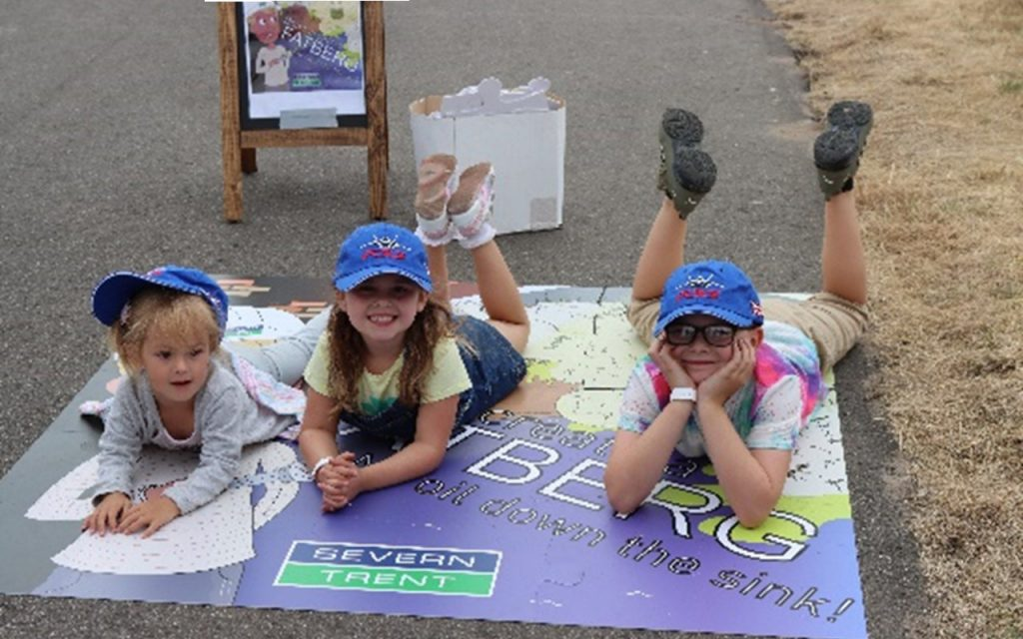
Water
Our findings:
Self closing taps and low flush cisterns installed
Waterbutt on site but not connected
Suggested actions:
Re-install water butt – reconnect and use water in gardening activities
Raise awareness around water consumption and efficiency through workshops and displays - Severn Trent

Slide 17
Biodiversity & Green Infrastructure
Creating habitats and adopting practices that will enhance species diversity on the school estate and beyond.
Pillars to be discussed:
    Nature

Slide 18
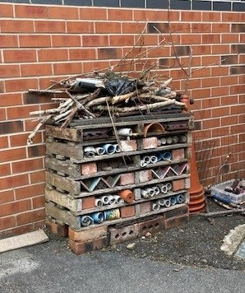
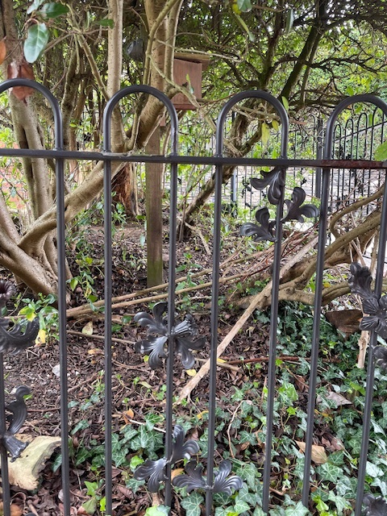
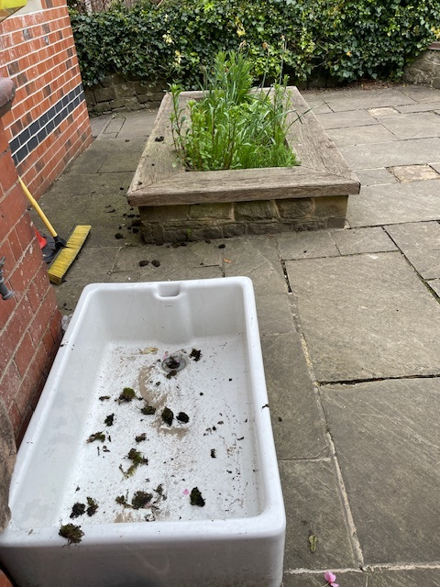
Nature
Our findings:
Created outdoor learning spaces and suitable accessibility
Established a Class 1 gardening/ nature club
Yr 2 and 3 pupils carry out wildlife surveys within science
Increasing biodiversity to support local wildlife e.g. pollinator-friendly plants, birdfeeders, bat boxes and 'bug hotels’
Take part in Big Garden Watch every year
Increase engagement with nature resources across year groups
Suggested actions:
Register with The Nature Park (NENP)
Use curriculum linked Nature Park resources for all year groups eg habitat mapping
Switch to Ecosia as default search engine
Create small wildlife pond using old sink

Slide 19
Climate Education, Green Skills & Careers
Ensuring the education you provide gives knowledge-rich and comprehensive teaching about climate change, and that your teaching staff feel supported to offer this.
Pillars to be discussed:
    Curriculum
    Culture
    Green Skills & Careers

Slide 20


Curriculum and Green Skills
Our findings:
Carly carefully curates English texts to educate on wider issues such as climate change and justice
Created an environment where lessons can be taught outside in all subjects
Set up a forest school
Some opportunities for pupils to lead on environmental issues – school council
Suggested actions:
Run EcoRefills shop (funded spaces available – deadline for EOI 30th June 25
Complete a curriculum audit & incorporate sustainability
Survey staff on how they feel about teaching sustainability issues
Provide CPD opportunities for staff on sustainability
Provide opportunities for all pupils to take part in sustainability initiatives eg switch off fortnight, recycling

Slide 21
Culture
Our findings:
Signed up to Lets Go Zero
Carly as Sustainability Lead will incorporate CAP into SIP
Nominated Sustainability Governor - Cate
Suggested actions:
Share sustainability goals/ practices/ successes on your website and newsletters
Ensure that policies and procedures are reviewed with sustainability as a criteria across all areas
Set up a sustainability working group including Sustainability Governor (Cate), staff, possibly PTA?

Slide 22
Action Plan Longlist
Based on our findings at your school, we have put together a list of recommendations for you to review.
Your recommended actions
Next steps
References

Slide 23
Longlist of recommended actions
Pillar | Action | Add to Climate Action Plan? | Timeframe for completion | Who will lead?

Slide 24

Your potential carbon savings
We estimate that by committing to the following actions, you can potentially make further savings of up to X tonnes of co2e emissions. This would be a X% reduction against your current baseline.
Take part in a switch off campaign
Monitor energy use on a regular basis through platforms such as Energy Sparks
Use workspaces efficiently to limit need for heating and lighting during and after the school day
Power down strategy for appliances (fridges and freezers over holidays)
Reduce the quantity of meat in meat based meals
Introduce an additional plant based/ Planet friendly day
Switch to use washable/ reusable plates and cutlery to reduce waste
Reduce/ Stop sale of disposable bottles and cans.
Consider installing a juice dispenser to replace prepackaged bottles.
Engage with a plastic reduction campaign e.g. Surfers Against Sewage
Establish procedures for the reuse of school supplies
Consider carbon footprint and environmental practices of the services/companies you use
Factor in energy efficiency when buying new equipment such as ovens, fridges, kettles etc. (using efficiency ratings to guide purchases)
Reuse school uniform through a Uniform Exchange
Reuse PE Kit through a Uniform Exchange

Slide 25
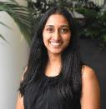
Next steps
Next week
Within 1 month
Term X
Term X
Term X
We will send over your Climate Action Plan and guidance on getting started
We will meet with key staff to go through action plan
Check-in on progress and review actions
Celebration of success with whole school assembly
Redo Count Your Carbon calculation
Review actions and add to action plan
Contact your Climate Action Advisor anytime with questions or updates of your progress.
XXXX@letsgozero.org
www.letsgozero.org
charity no: 1104153
Notes:
Adapt timeframes and actions to reflect your plans with them. Add specific months eg – April 2024 / Autumn term etc.
For headshot, change formatting to: ‘Bevel rectangle’ and on Picture effects ‘Remove reflection’.

Slide 26
References
¹ Energy Sparks, For schools. Available at: https://energysparks.uk/for-schools (accessed DATE)
Notes:
Use this slide for references or add in brackets on the relevant slide

