Slide 1
Welcome to Class 2
2021/22

Slide 2
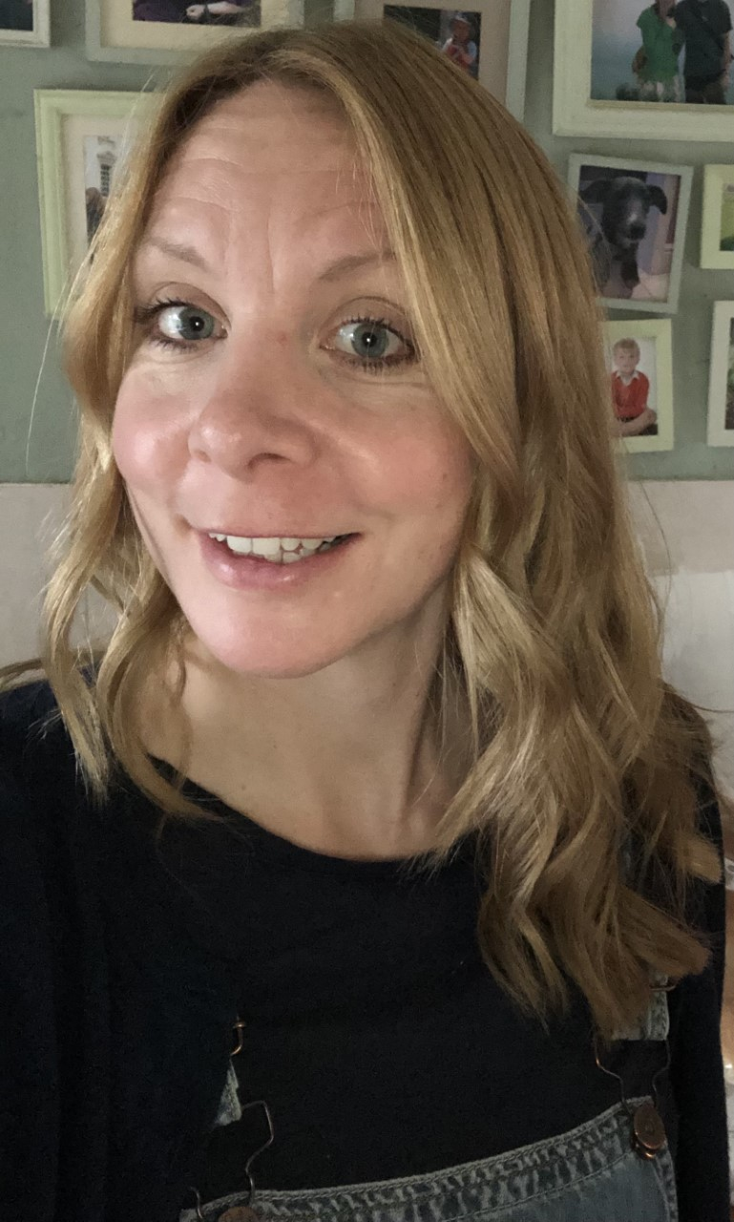
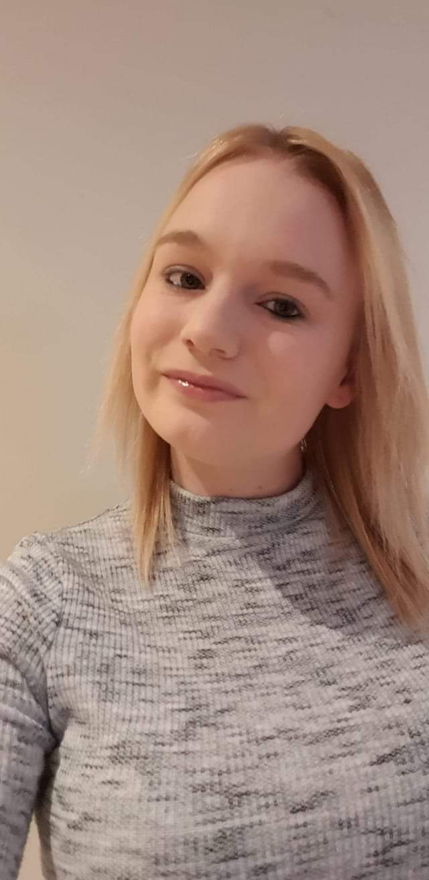
The Big People in Class 2
Mrs Turner
Miss Julian

Slide 3
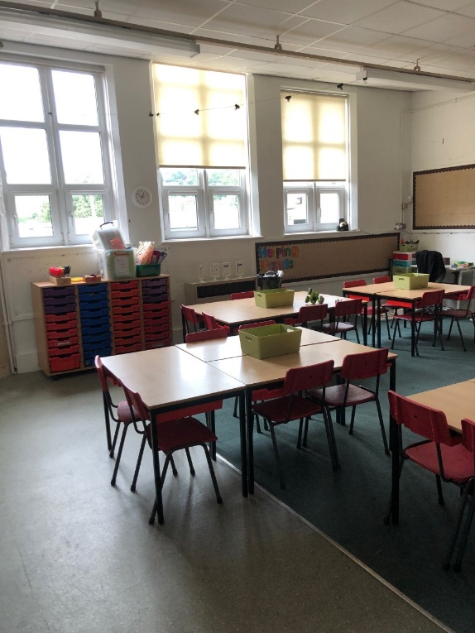
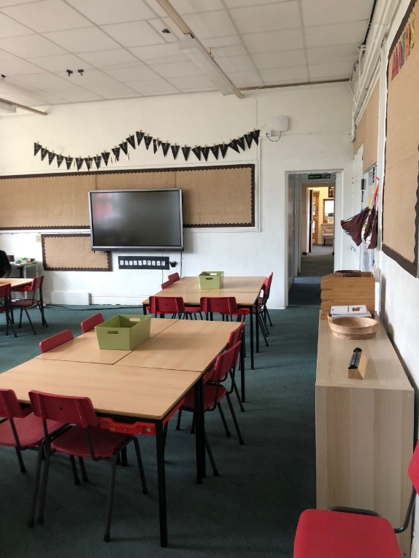
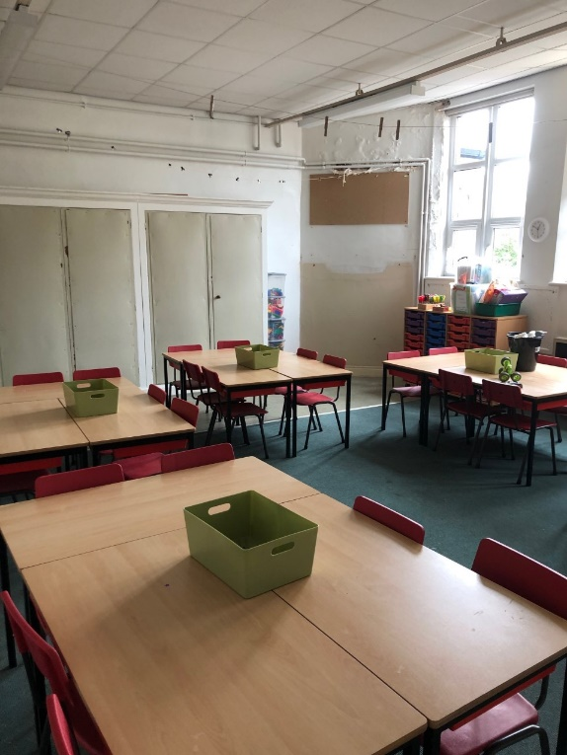
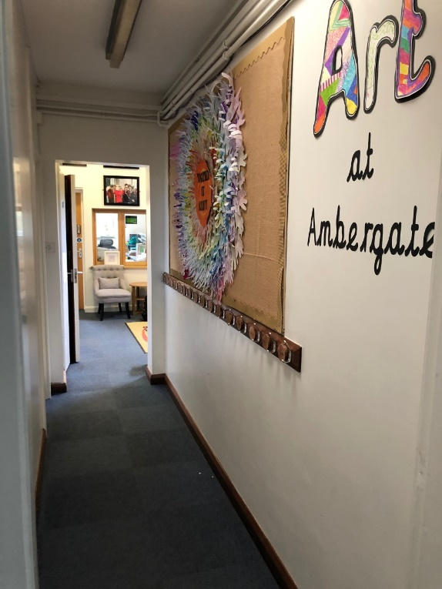
Our Classroom
Our classroom is nearly ready. Some workmen still have a little work to do on the chimney and then that will be our reading area – ‘Starbooks’ themed! The walls are very bare but I am sure that they will be filled with some fabulous work very soon.

Slide 4


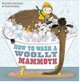

Autumn Topic (History focus) - Stone Age
Our first topic will be ‘Who Lives in a Place Like This?’ We will be travelling back in time to the Stone Age to find out what life like. Our Science work on stones links in closely with the history element. Later on in the term we will hopefully be visiting Creswell Crags to see some caves and cave painting. The key concepts being taught through this topic are: Belonging, Individuality, Poverty and Well-being.
These are the texts that we will be focusing on in English.

