Slide 1
Ancient Sumer
By Violeta and Ruby

Slide 2
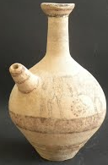
Pottery
The Ancient Sumer's loved there pottery very much. They decorated the pottery with red and black limestone, shells, lapis lazuli, gold and clay. They made bowls, vases and pots. They made a lot of pots with a spout for holding oil, water or wine.
A Sumerian Pot!

Slide 3
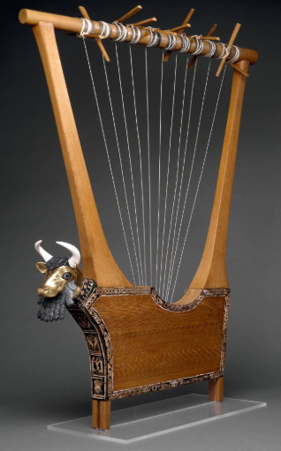
Music
The Sumerians enjoyed playing music and listening to music. They played the following instruments: Flutes, drums harps, etc.. They made many of the instruments they played from animal bodies, bone and wood.
This a Sumer harp.

Slide 4
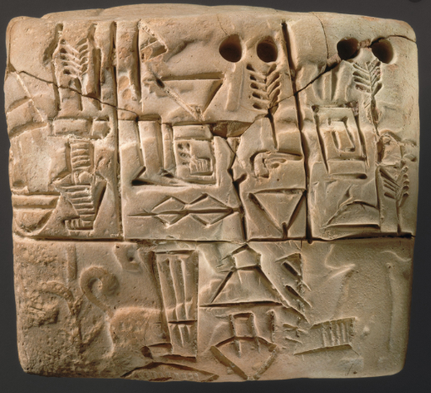
Writing
The Ancient Sumerians wrote on large clay tablets (Big clay boards) in pictures similar to the Ancient Egyptians hieroglyphics.
Ancient Sumerian tablet!

Slide 5
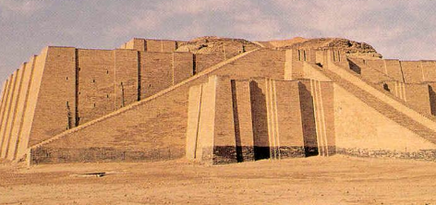
Temples
The Sumers had large temples to worship there gods. They are pyramid shaped sometimes with a long hallway to the central room of the temple.
A Sumer Temple!

Slide 6

Thank you for reading!

