Slide 1
Ancient Sumerians
By Isla P and Isla H

Slide 2
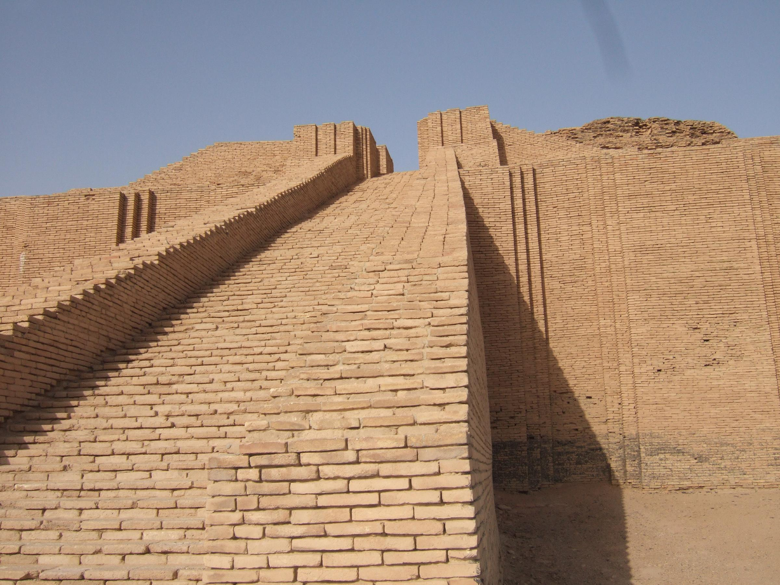
Information
Ancient Sumerians were great at pottery, clay was always available. They often added decorative features. They also made jewellery and artefacts, they were skilled musicians. They were very fond of music. The Ancient Sumerians decorated pottery with shells and black and red limestone.

Slide 3
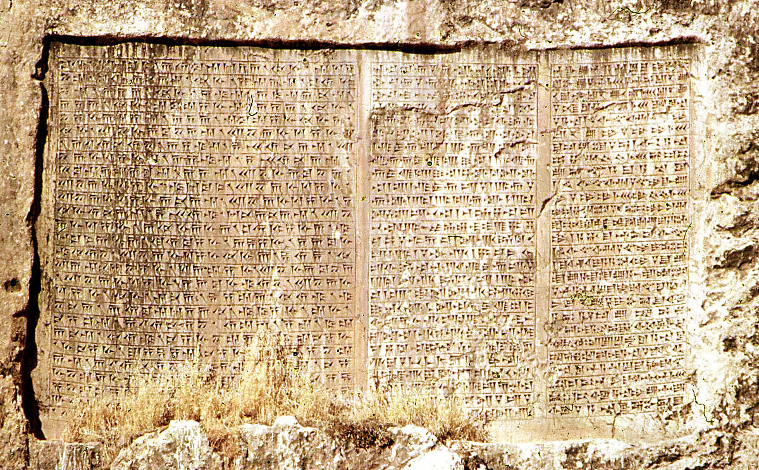
Sumer Time line
In 3300 BC the first writing is invented and pictures are written on pieces of clay. In 3200 BC they invented wheels to be used on vehicles. 2700 BC king Gilgamesh rules a city state called Ur. In 2330 BC the Akkadians conquer most of Sumer. Sargon 1 creates the worlds first empire, the Akkadian Empire.

Slide 4
Sumer buildings
Mostly the Sumerians built there houses out of mud –bricks which are called ziggurats. The Sumerians also built town walls around their towns, also mainly out of mud brick.

