Slide 1
ANCIENT SUMER
Fred reuben

Slide 2
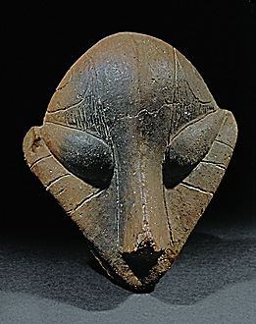
The sumerians gain power after
The Akkadian empire falls.
JEWELLERY
There jewellery was often made out of silver and gold. The most common was a bracelet or a necklace. The Ancient sumer’s were very good at pottery.

Slide 3
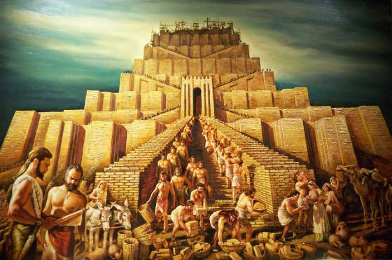
ANCIENT SUMER GOD
There is 5 gods: Enlil, Enki, Ninhorstag, Utu, Nanna. Nanna is the god of the moon.
Hammurabi dies, the bobylonian empire crumbles.

Slide 4
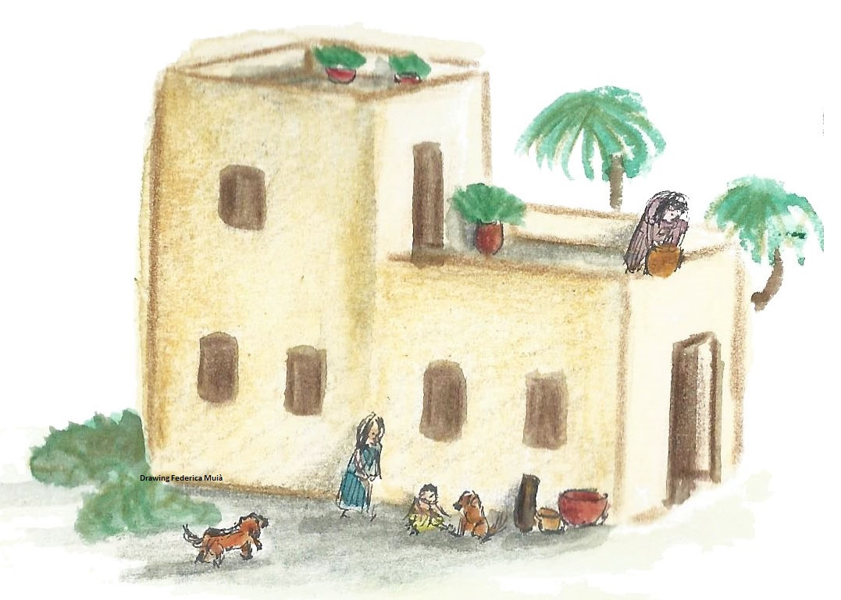
The Ancient Sumerians were around in the 1840s . They used to cramp there houses together for warmth in the cold winter days .If you were welthy you got a big house with multipul rooms. If you were poor you got a one room house .

Slide 5

END

