Slide 1
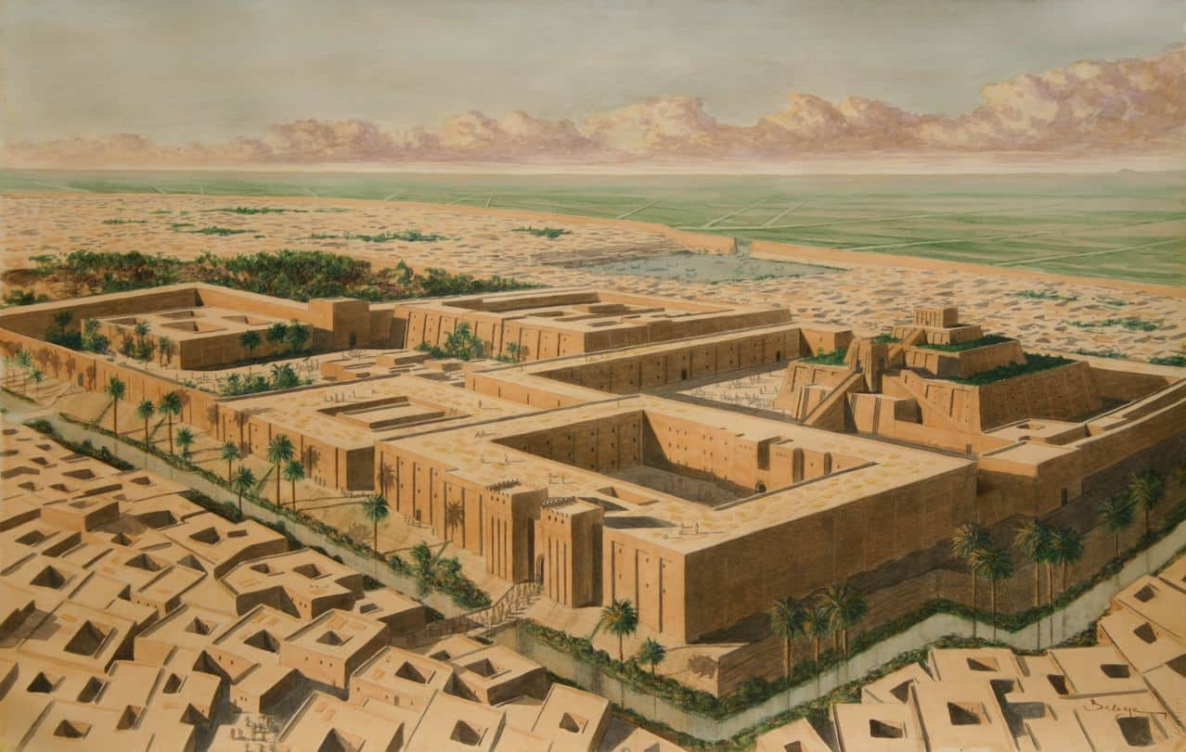
Ancient Sumerians!

Slide 2
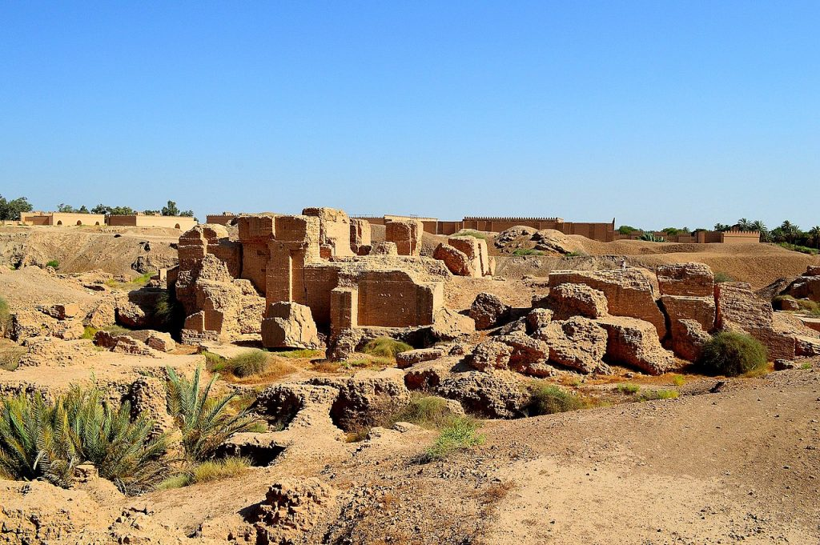
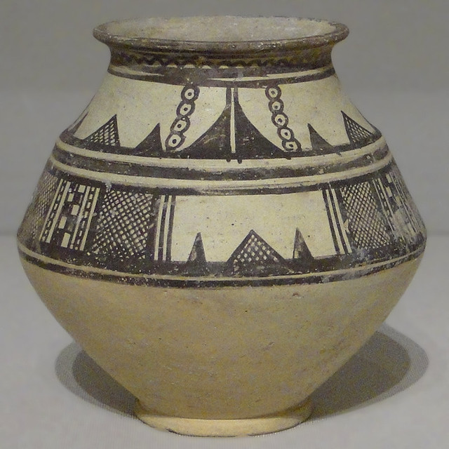
Ancient Sumerians made
beautiful pottery that they displayed all over their town. They also used it to store food and water. They used clay and paint to make these wonderful pieces of art.

Slide 3
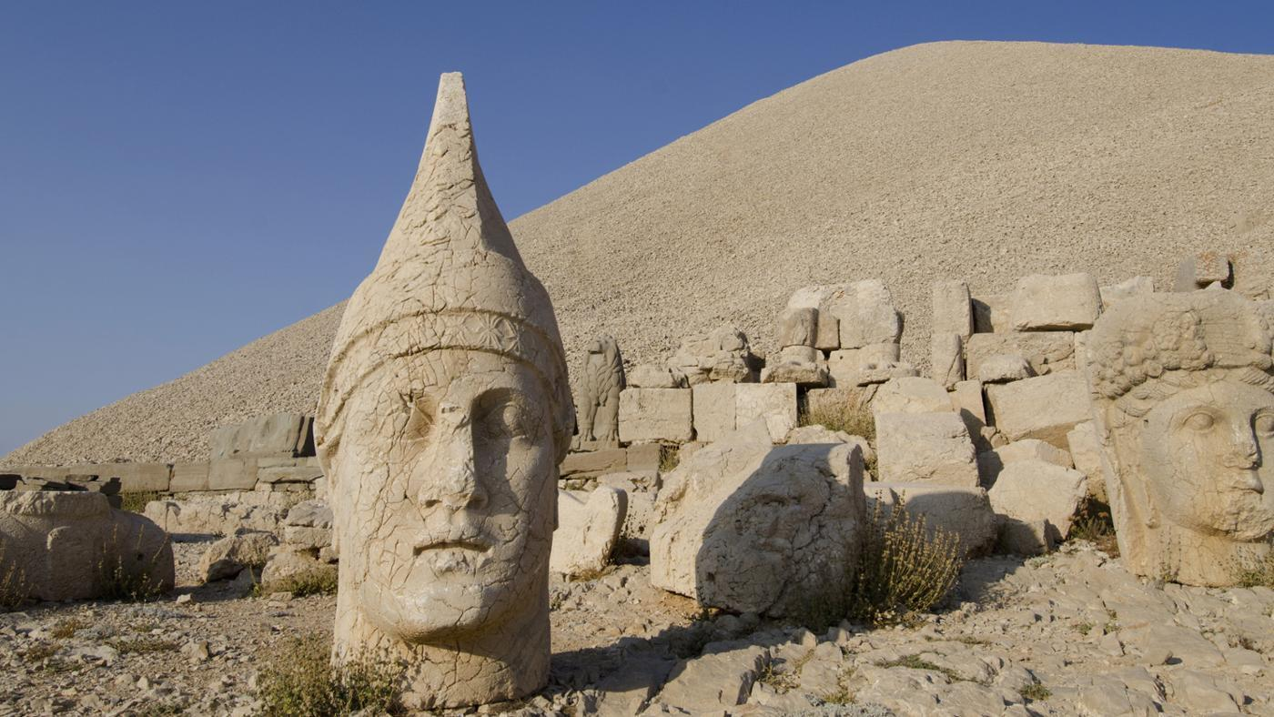
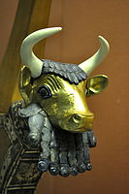
In ancient Sumer times there were for kinds of people: The priest, Royals, The poor and the slaves. The royals were very rich and could afford things such as jewellery and expensive pottery, this was very lucky in the ancient Sumer times.

Slide 4
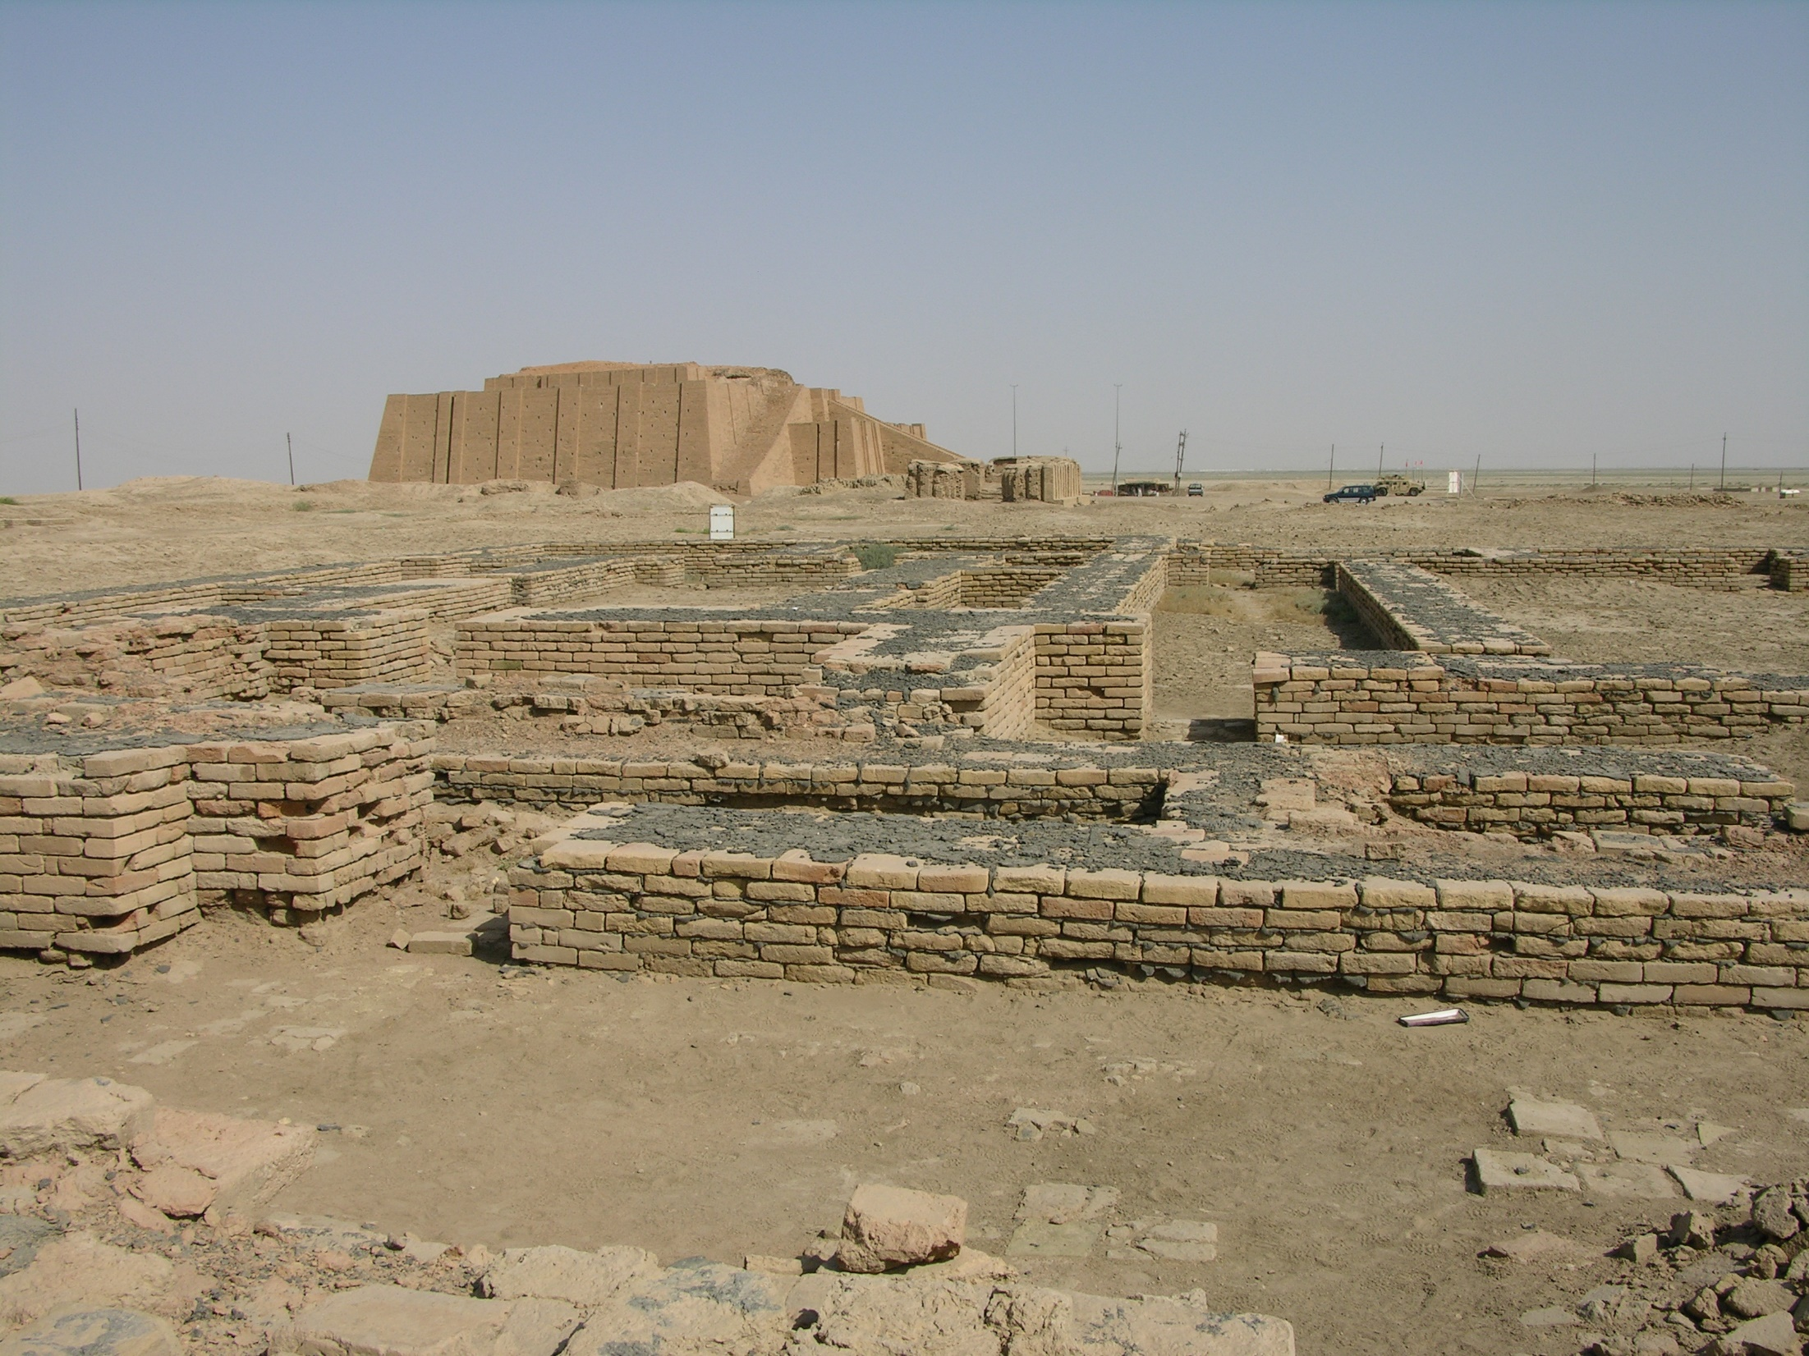
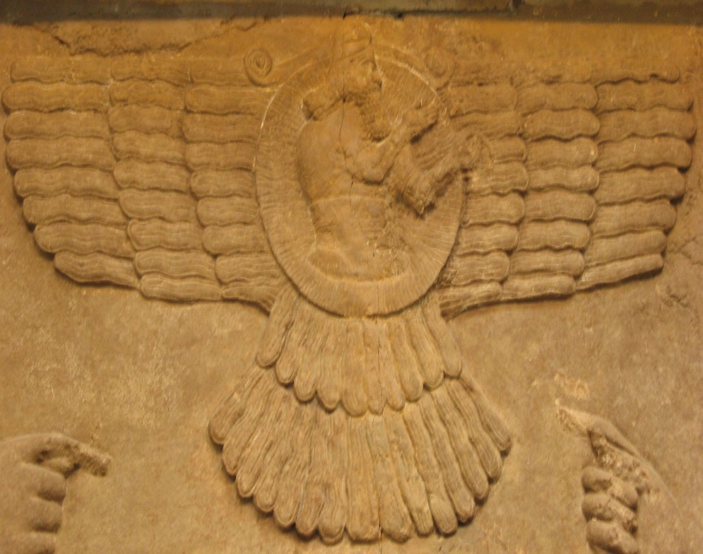
The ancient Sumerians believed that everything that happened to them (Good or Bad) was the result of god’s pleasure. They had many gods that they worshipped in Ziggurats.

Slide 5
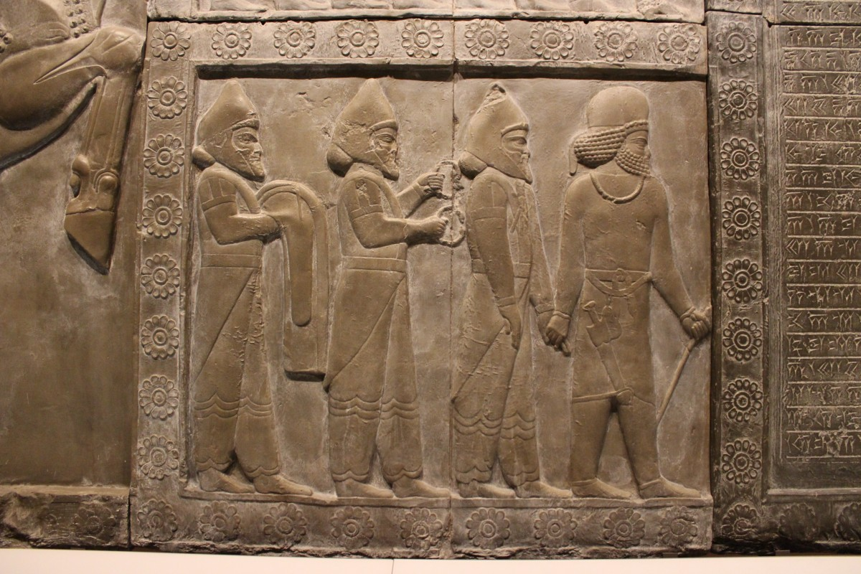
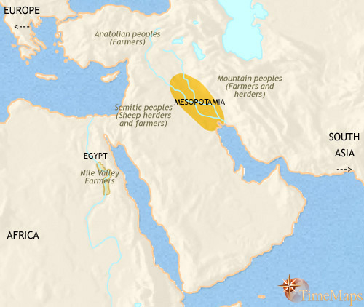
Ancient Sumerians had many cities and one great city was called Mesopotamia and had a famous river
Running through it. They only built around the river so they could get an easy water access and so they could have a sewage system.

Slide 6
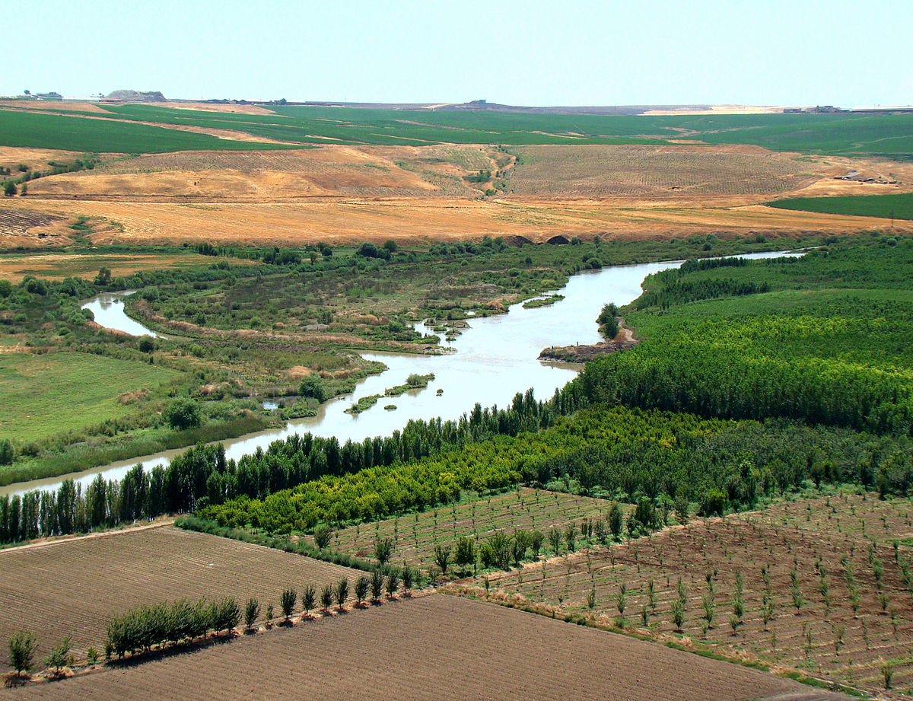
Thank you for watching our
Slide show by Ava, Cliona and Darcey!!!!!

