Slide 1
ANcIENT SUMER

Slide 2
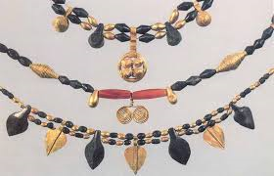
Jewellery
The ancient summers hand make all there jewellery for all there standard needs and beauty.
There jewellery often contained flint, sapphire and gold. They were the common materials but they did use other materials.
They made bracelets, rings, necklaces, headbands, ankle bracelets and ear rings.

Slide 3
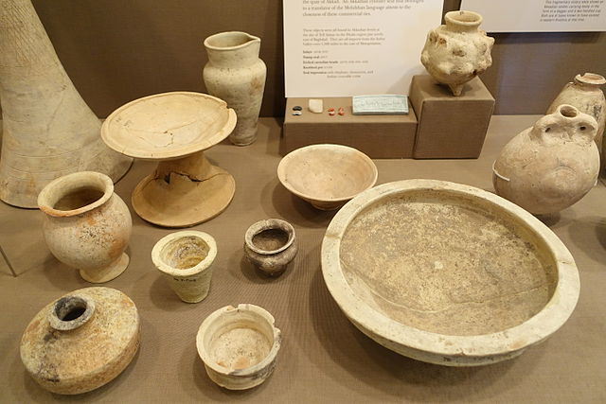
Pottery
Pottery is made for having food and every day needs. Pottery is also good for cooking because when it gets hot it doesn’t melt. Pottery is also good for getting fish and water and you can create houses with them by shaping them into a brick.

Slide 4
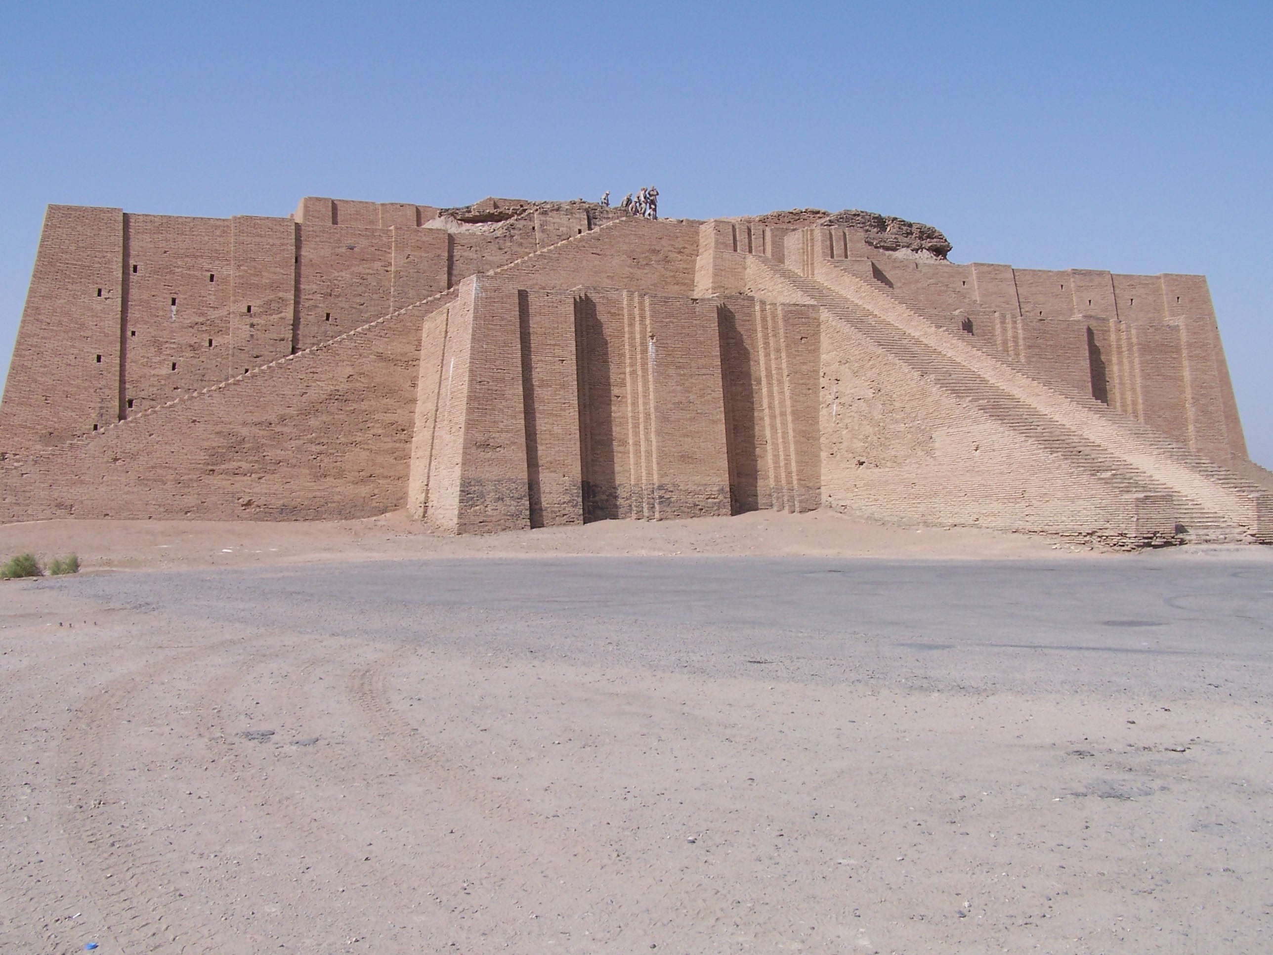
Buildings
If you are in a building you can be a slave to a king in a few years.
The buildings are made out of sand , clay, metal, and different wood.
There are no more ancient Sumerians buildings but there is still some wrecks from it.

Slide 5
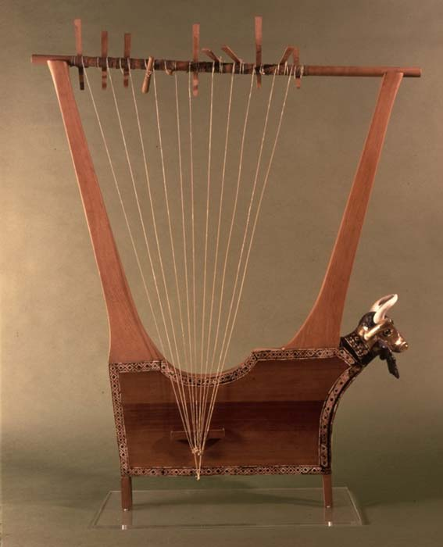
Instruments
Instruments are used to calm the children or make them fall to sleep.
They use to decorate there instruments really nice with gold, sapphire and wood.
They use to play really relaxing tunes on them and make people calm.

Slide 6
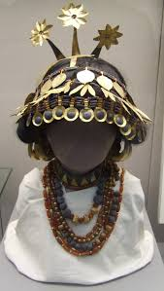
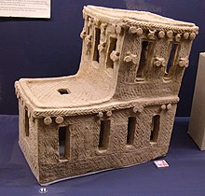

Slide 7


