Slide 1

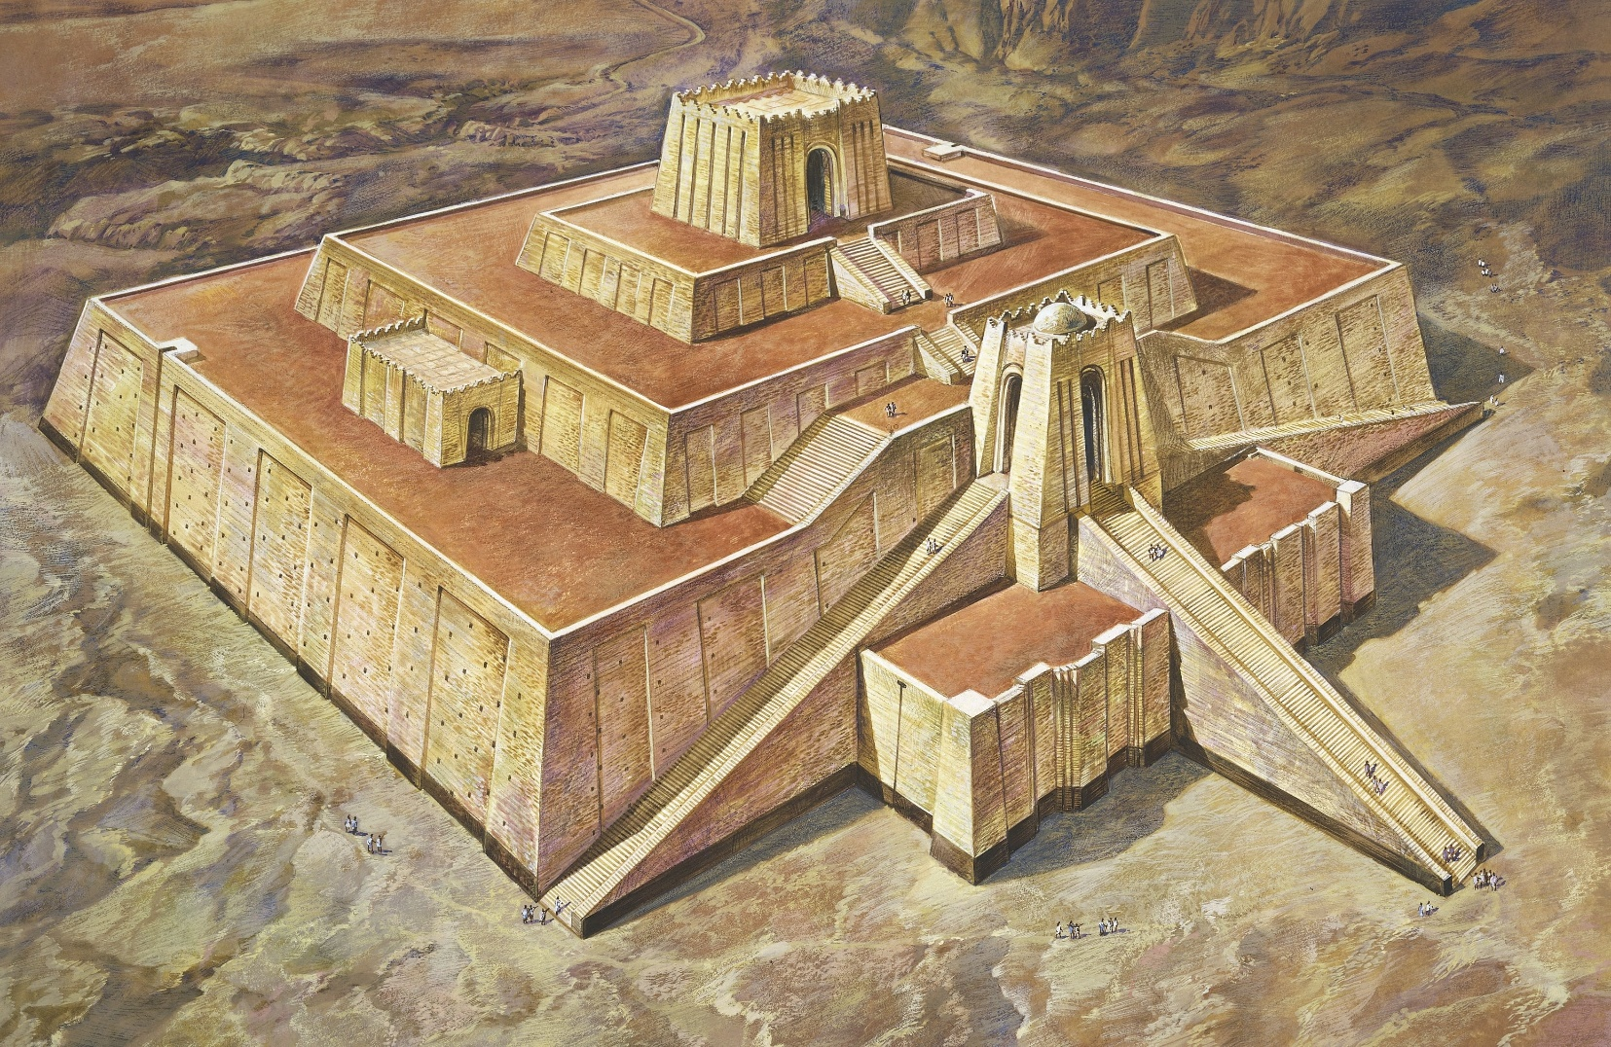
Ancient Sumer

Slide 2
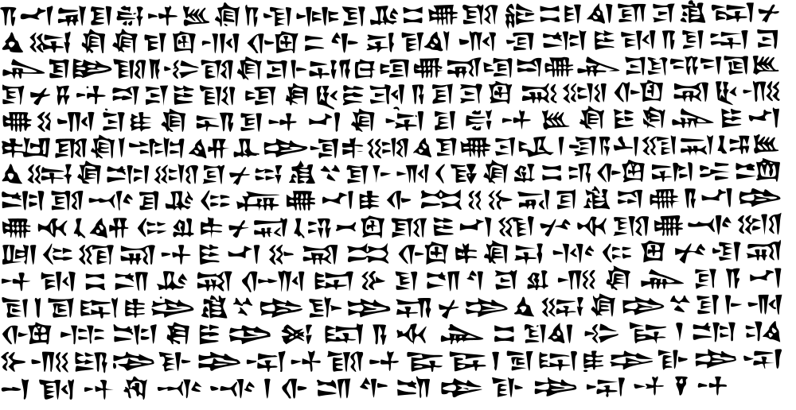
Ancient Sumer writing

Slide 3
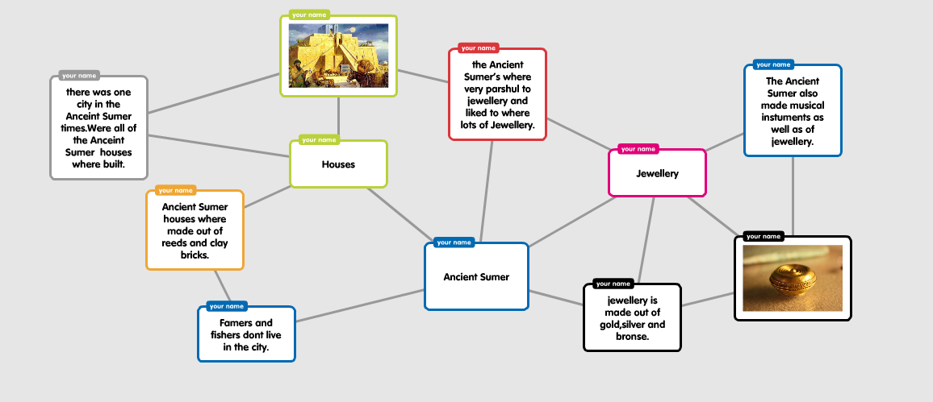

Slide 4

The end
Made by Auburn, Finlay and Alfred

