Slide 1
Ancient sumer

Slide 2
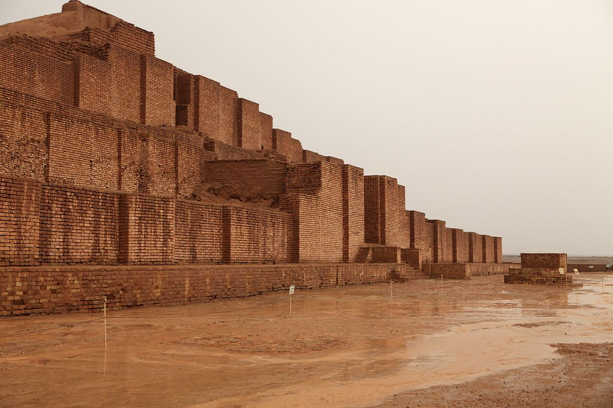
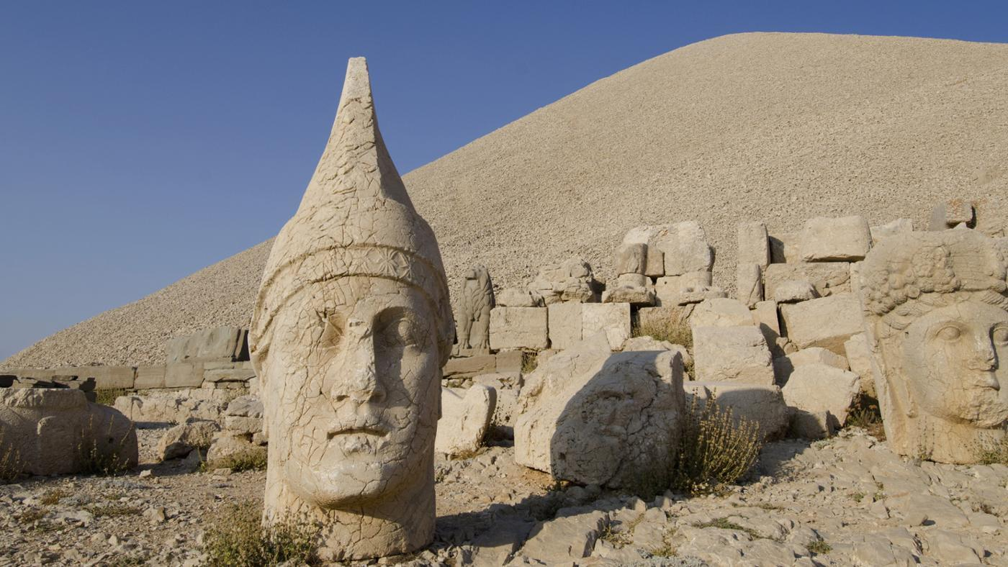

Slide 3
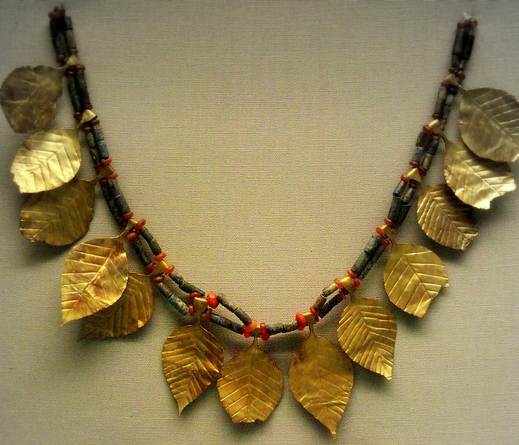
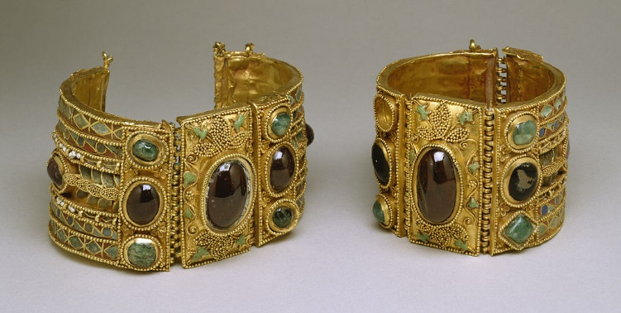
Jewellery
The Ancient Sumerians made jewellery out of ,gold, lapis and lime stone. The oldest piece of Ancient Sumer jewellery is meant to be 100,000 years old . The jewellery was firs made in Mesopotamia.

Slide 4
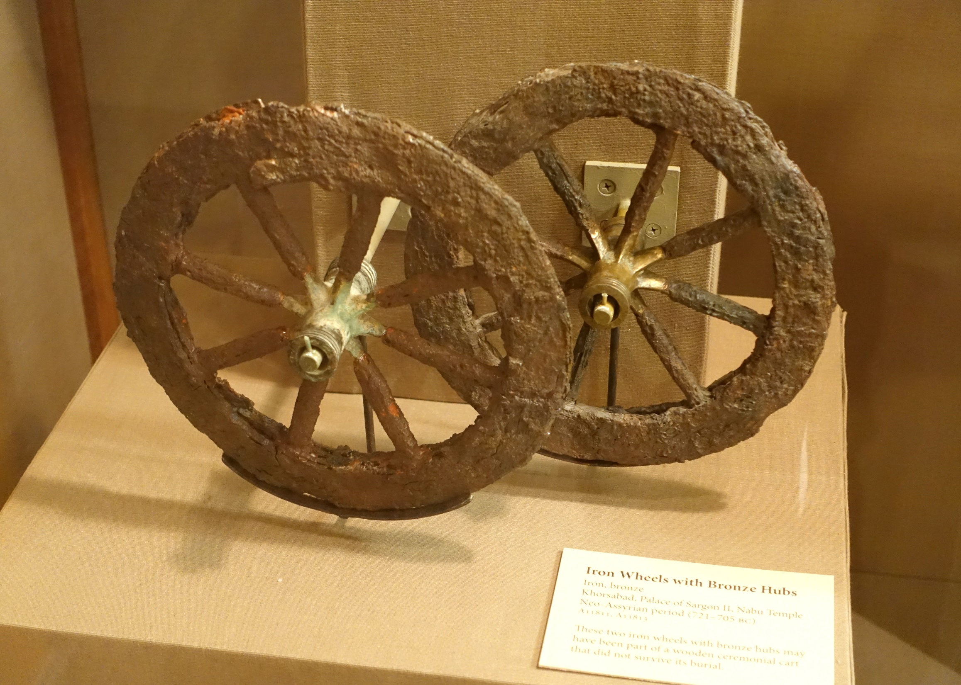
Inventions
In 3200 BC they invented wheels for vehicles also they made good sewage system.
They were also exquisite at making jewellery and pottery.

Slide 5
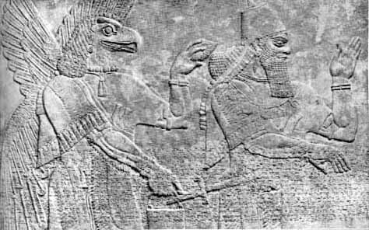
Ancient Sumerian Gods
There are six Sumerian Gods this is them:
Utu,
Enlil,
Enki,
Anunnaki,
Nanna,
and Ninursag.

Slide 6
Cities.
Ancient sumer had many cities but the biggest city was Uruk it was around in 2800BC. They made most of there jewellery in Mesopotamia.

