Slide 1
Ancient sumers
By Miley and Lily

Slide 2
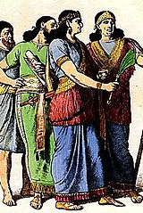
clothes
Both boy and girl wear skirts they go up to there knee and its typical for men. At one point men where very little.

Slide 3
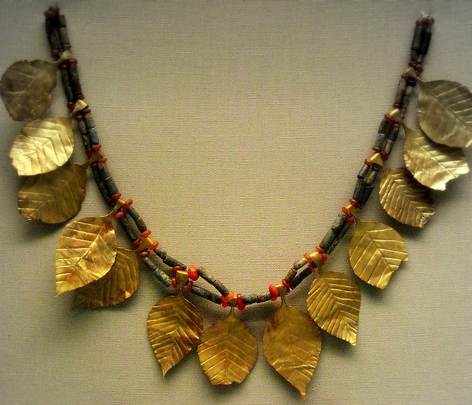
jewellery
Ancient Sumer's use gold and silver. They also used blue to make vase's and jars. They also make instruments and cups and statuses .

Slide 4
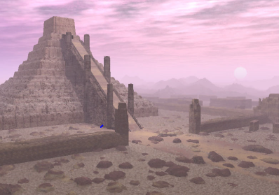
BUILDINGS
They liked temples and in the temples they prayed in a god room or in a praying room. Only the rich people have temples and nice houses and the poor have houses built out of reads mud and clay. The poor people have houses stuck together so heat can get to different people houses . Rich people have bigger house than poor people.

Slide 5
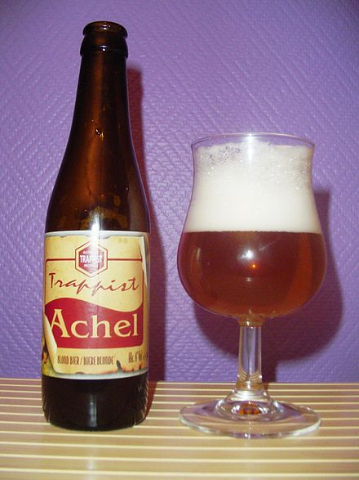
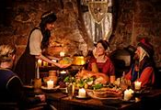
What they drink and eat
What drinks
What food

