Slide 1
ancient Sumerians
By Emily and Esme

Slide 2
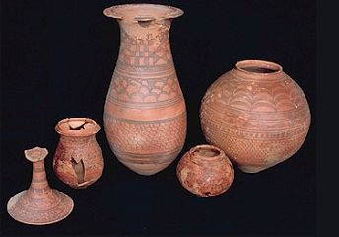
Pottery
Did you know that the Ancient Sumerians were very talented at making pottery? They make things like: statues, vases, bowls, jars, pouring pots, jugs and cups. The Ancient Sumerians, used all of these items when cooking, eating and drinking- they also use them for show and art galleries. Some of this fine pottery still exists today!

Slide 3
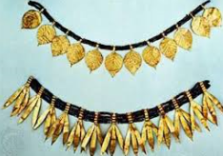
JEWELLERY
Ancient sumerians were very famous an well remembered because of there excellent jewellery. They made: necklaces, bracelets , earings, rings and much more incredible jewellery to wear every day. There jewellery is very bright, colourful and extremely vibrant.

Slide 4
Buldings
Ancient sumerians had incredible buildings. Normal people would live next to the river in a one room home. Most houses were made out of old bricks, clay and mud. Richer people lived in temples which had multiple rooms and were very posh. In a temple they would normally have a : worshiping room, banquet hall and discussion room.

