Slide 1
ANCIENT sumer
Made by Arlo,Max and Donal

Slide 2
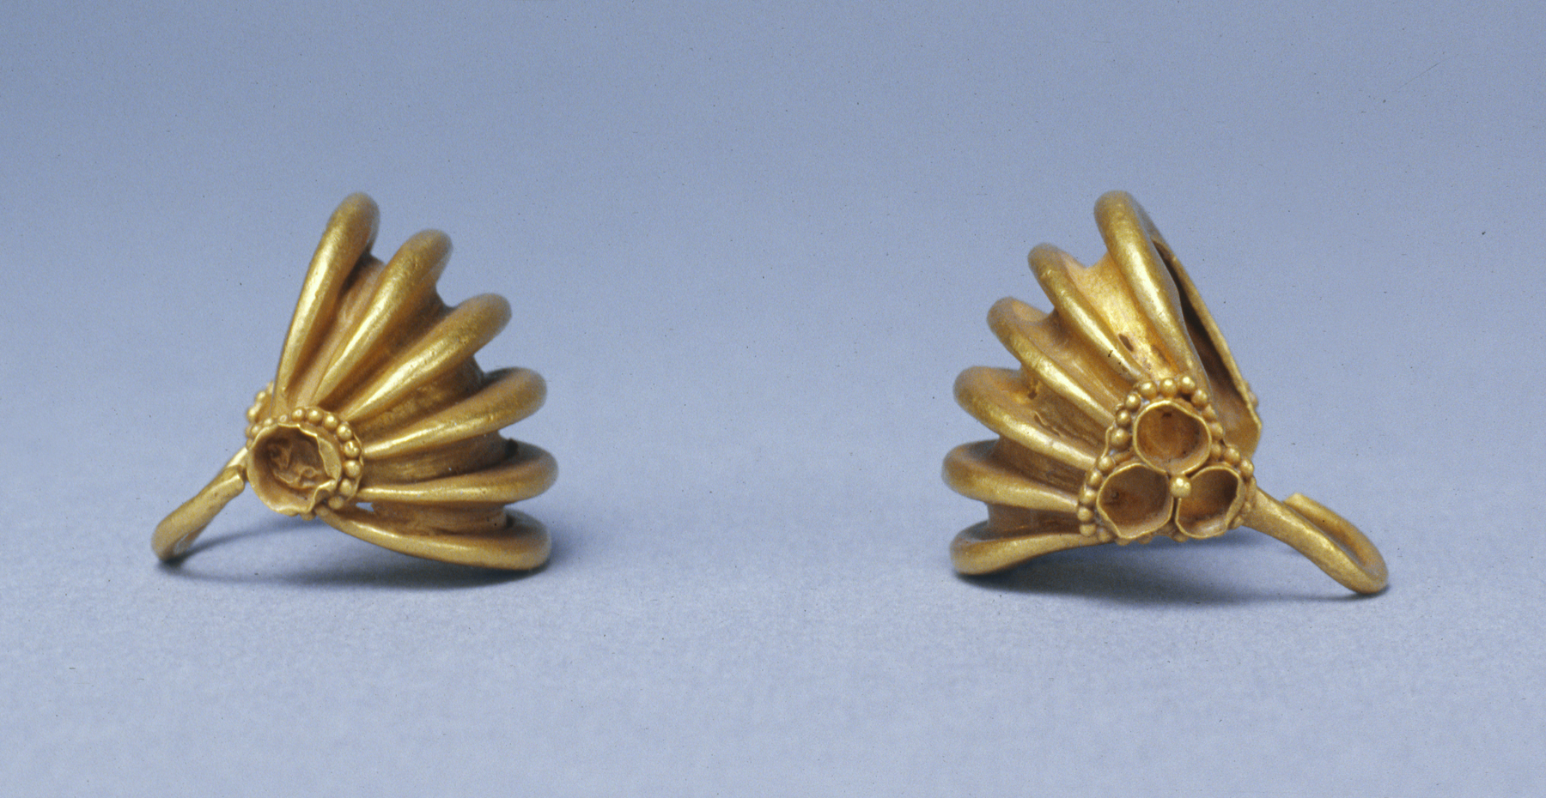
jewellery
The sumers had many metals and many tipes of jewellery like this.

Slide 3
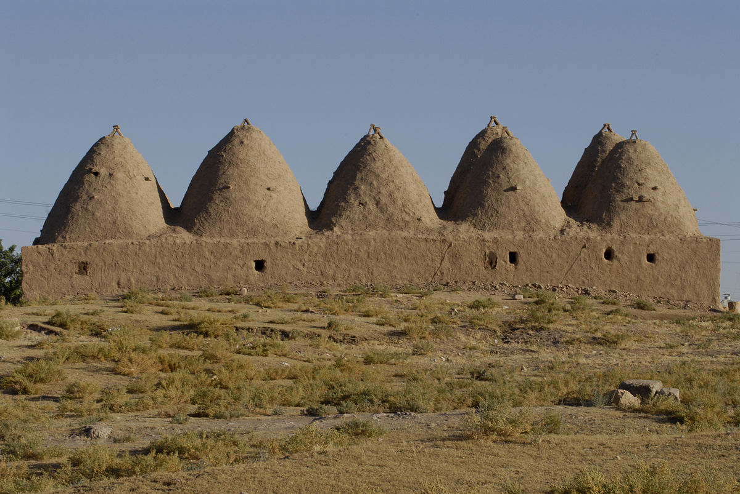
What there houses were made of
There houses were made of clay and sea weed.

Slide 4
What they invented
They invented the suiers the flushing toilet and farming and other things.

Slide 5
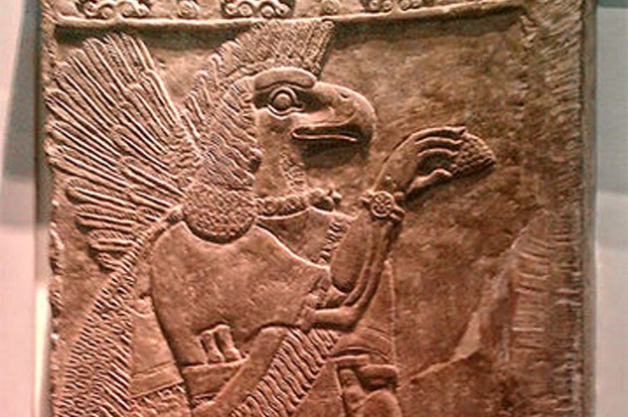
The sumerians gods
They have many gods like this god.

