Slide 1
Ancient sumers
By poppy and libby

Slide 2
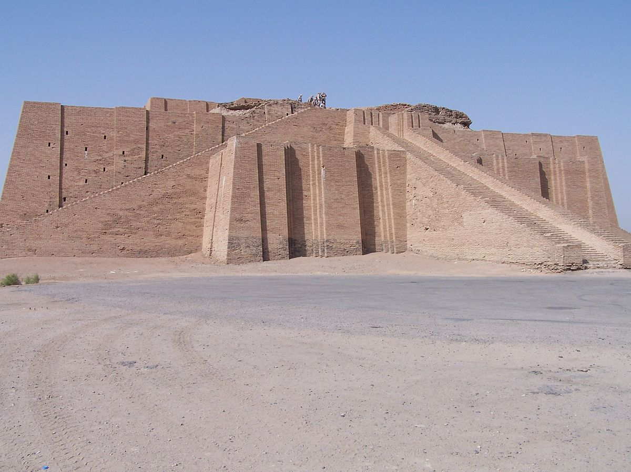
Houses!
The rich sumers have temples and the poor summers have ordinary houses. Some sumers build temples to worship their gods . In their houses they have a worship room , banquet room,wash room,warm room and resting room.

Slide 3
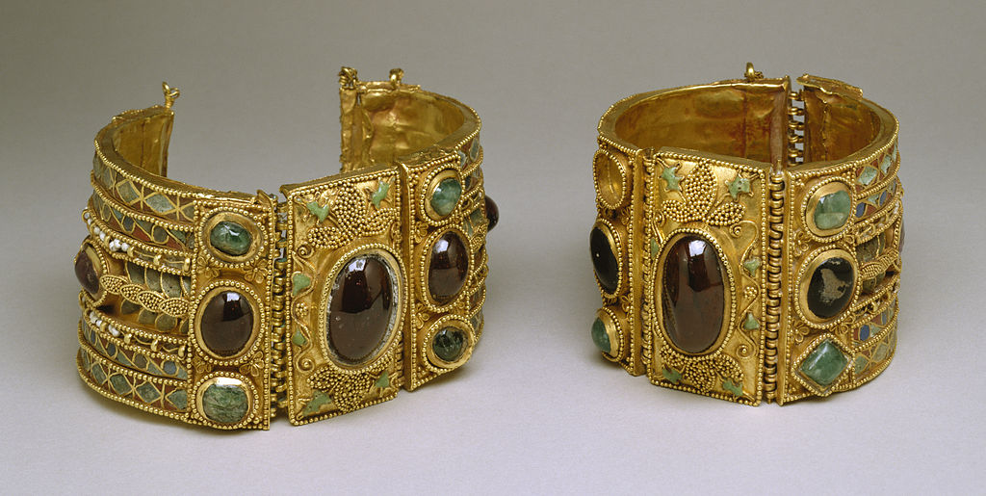
Jewellery!
When ancient summers make necklaces they use blue and gold.They are very good at making pottery they did not just use clay . The summers were very skilled potters from there time .the summers had a lot of clay .

Slide 4
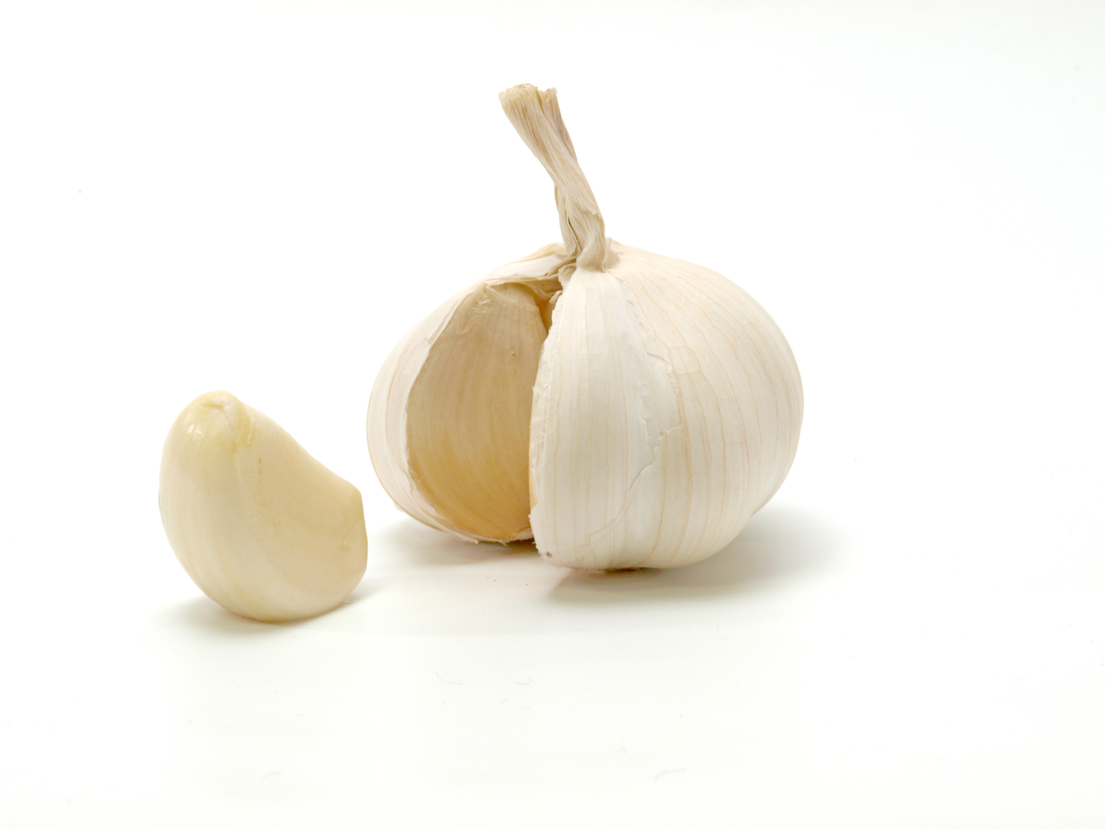
food
They grow wheat , barley , lentil, beans, garlic, onions and milk.

Slide 5
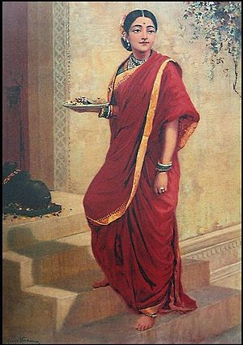
Clothes!
Ancient summers spun wool and wove cloth ,then men dyed the fineshed cloth.
Did you know both men and women wear skirts.

Slide 6
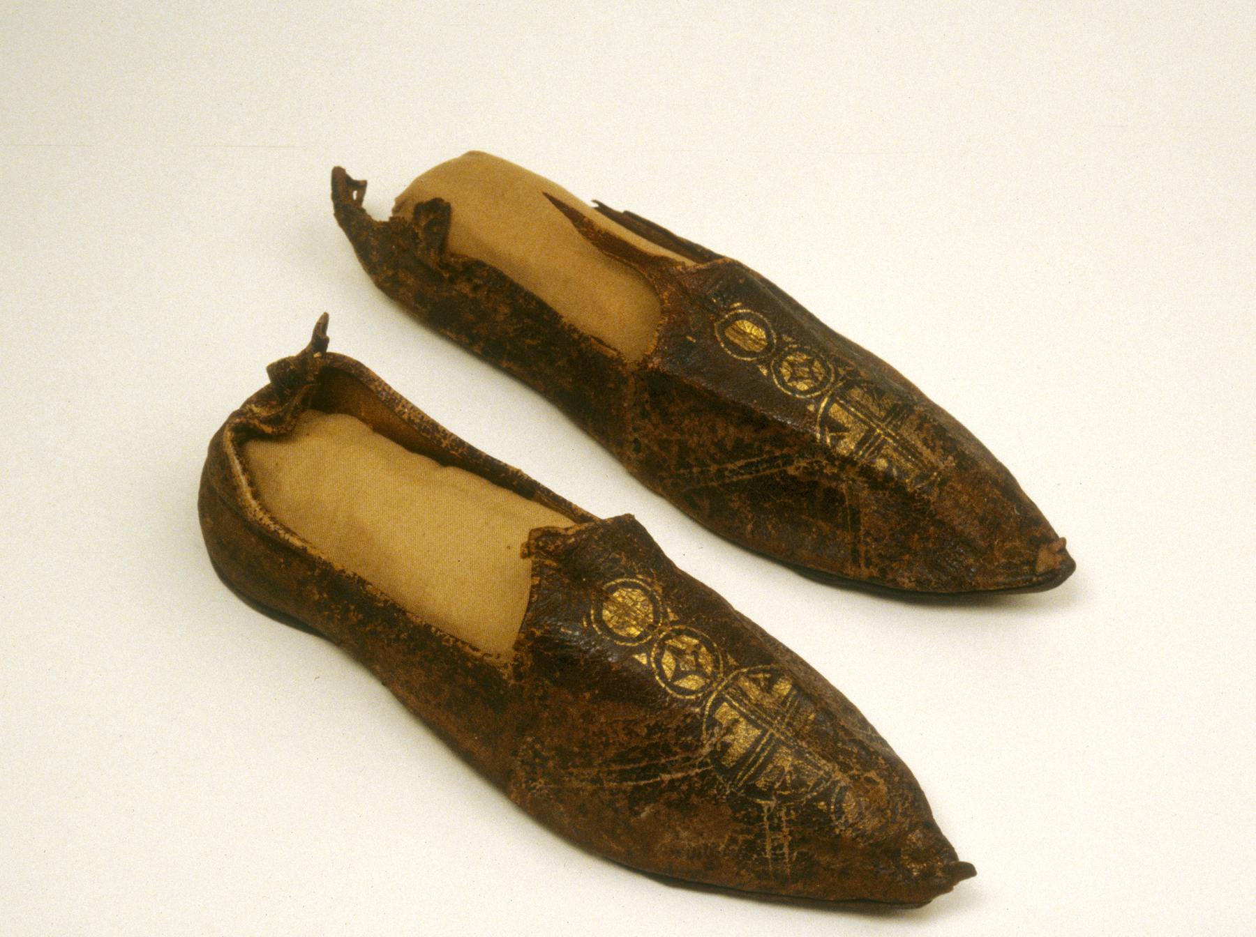
Shoes.
Sumers wore sandels as there shoes and they also wore pumps.

