Slide 1
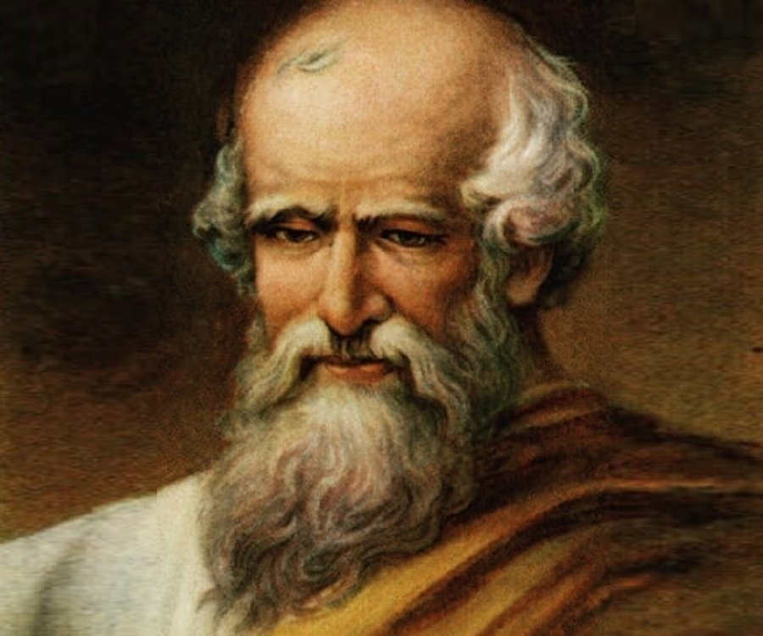
ARCHIMEDIES

Slide 2
WHO HE IS ?
Archimedes of Syracuse was a Greek mathematician, physicist, engineer, astronomer, and inventor. Although few details of his life are known, he is regarded as one of the leading scientists in classical antiquity. Considered to be the greatest mathematician of ancient history, and one of the greatest of all time

Slide 3
WHEN HE LIVED
Archimedes was born c. 287 BC in the seaport city of Syracuse, Sicily, at that time a self-governing colony in Magna Graecia. The date of birth is based on a statement by the Byzantine Greek historian John Tzetzes that Archimedes lived for 75 years

Slide 4
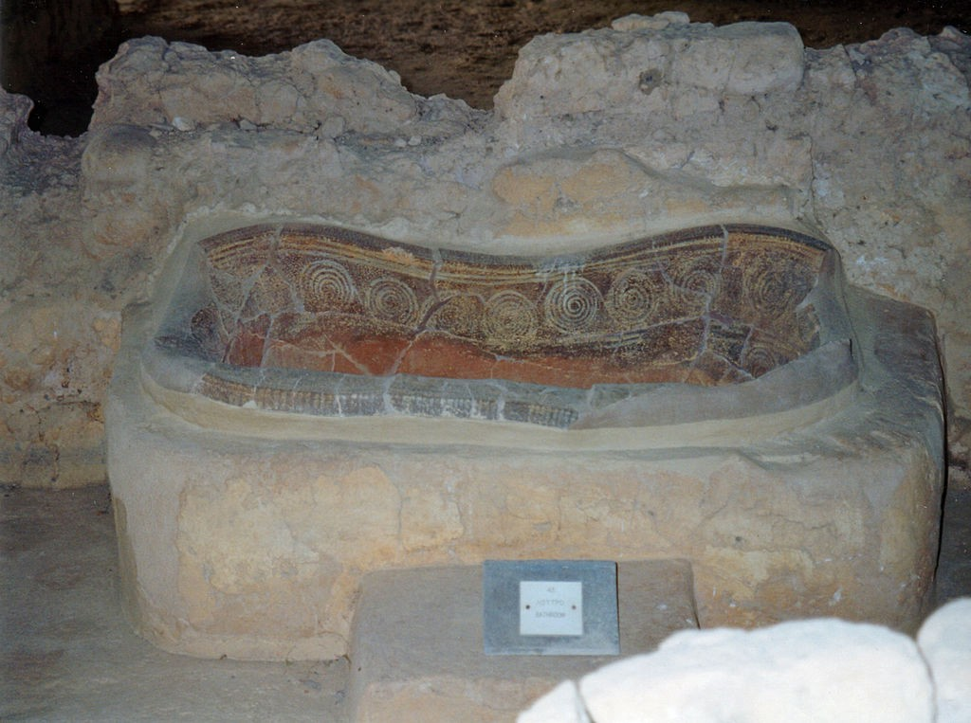
THE BATH IDEA
The king asked if Archimedes would see if his crown was made out of gold. It was a challenging task, as the precious crown could not be damaged in any way. The idea that saved Archimedes came to him in the bathtub. The bathtub was almost full. When Archimedes slipped into it, the bathtub began to overflow. Archimedes noticed that the volume of the water overflowed corresponded approximately to the volume of his own body. He concluded. The volume of bodies and even their density could be calculated by the volume of water they displaced. He realized that he could use the water method to determine mathematically whether or not the crown was of pure gold.

Slide 5
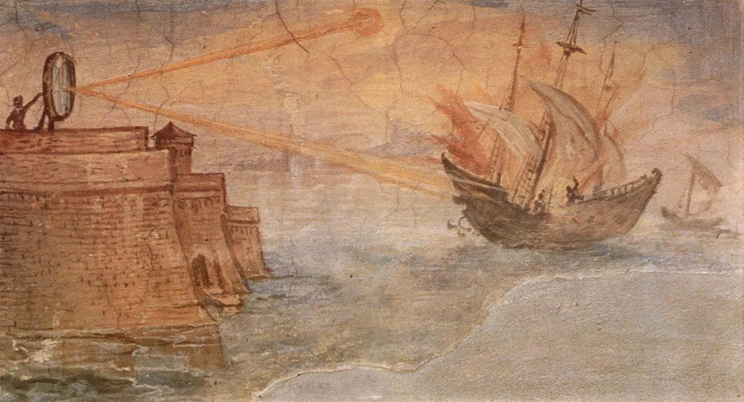
HEAT RAY
Centuries later, Anthemius of Tralles mentions burning-glasses as Archimedes' weapon. The device, sometimes called Archimedes heat ray, was used to focus sunlight onto approaching ships, causing them to catch fire. He used this in battle to stop ships invading

Slide 6

DEMOCRACYS
Ancient Greek civilization flourished from the period following Mycenaean civilization, which ended about 1200 BCE, to the death of Alexander the Great, in 323 BCE.

Slide 7
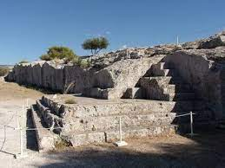
THE PNYX
In ancient Athens, citizens would gather together on a dusty hill called the Pnyx. Here they would decide the All 30,000 citizens were men. Women and enslaved people didn't get a say. A citizen could speak for the time it took water to run from one jar into another. When this water clock ran out, it was someone else’s turn. A jury of 500 citizens decided if someone was guilty of law-breaking. Punishments included death. Citizens could also vote to get rid of people they disliked. Each man wrote a name on a broken bit of pottery called an ‘ostracon’. Anyone named more than 600 times got kicked out of the city. city’s laws and who should sit on its ruling council. This ostracon has the name 'Themistocles' written on it. He led the Athenian navy in the war with Persia, but was later ostracised (banished).

Slide 8
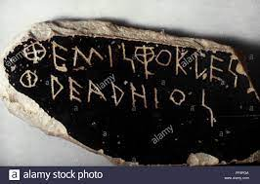
OSTRACON
An ostracon is a piece of pottery, usually broken off from a vase or other earthenware vessel. In an archologicalor epigraphical context, ostraca refer to sherds or even small pieces of stone that have writing scratched into them.

Slide 9

How did the Greeks change sport?

Slide 10
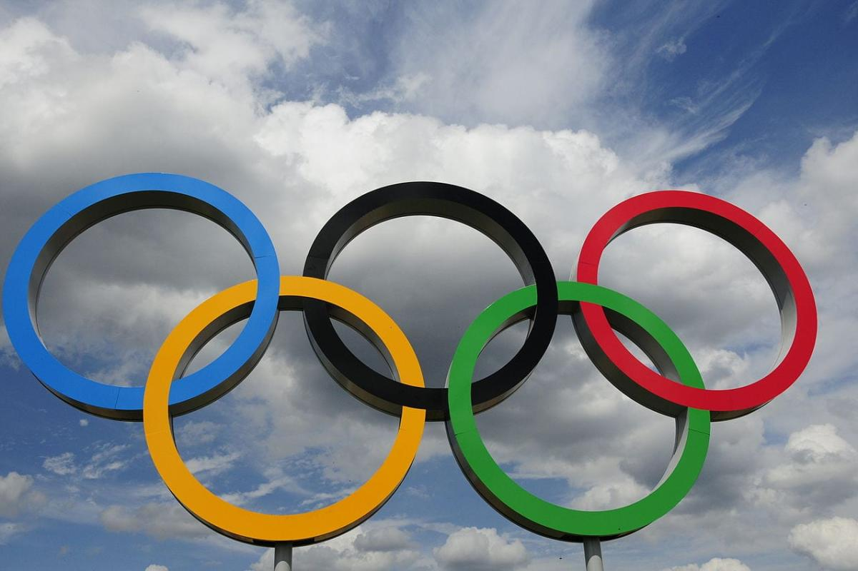
MODERN OLYMPICS
The modern Olympic Games or Olympics are leading international sporting events featuring summer and winter sports competitions in which thousands of athletes from around the world participate in a variety of competitions. The Olympic Games are considered the world's foremost sports competition with more than 200 nations participating

Slide 11
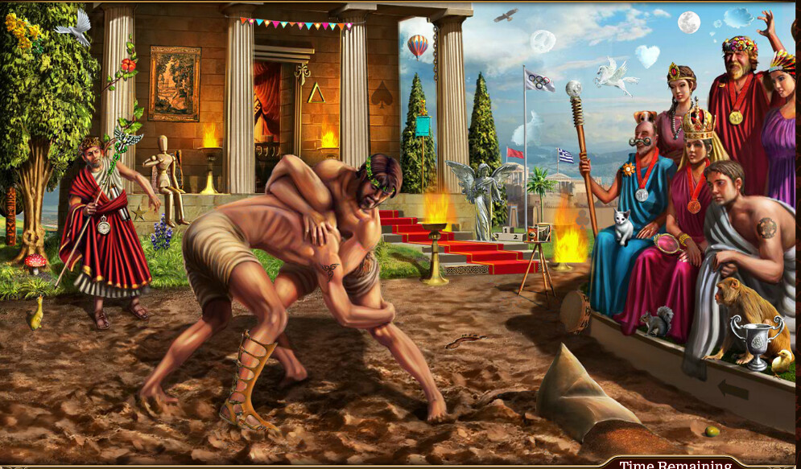
ANCIENT GREEK OLYMPICS
The ancient Olympic Games were a series of athletic competitions among representatives of city-states and one of the Panhellenic games of Ancient Greece. They were held in honour of Zeus, and the Greeks gave them a mythological origin.

Slide 12
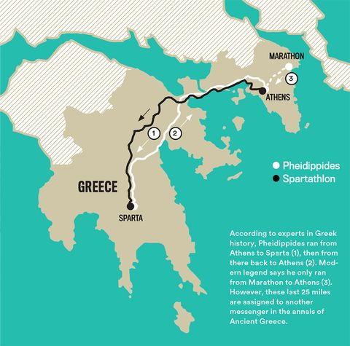
GREEK MESSENGER
                Every four years the Greeks held a special sporting festival at Olympia - the Olympic Games. These inspired the modern Olympics which began in 1896. Some of the events were very similar. Like the Greeks, we also hold the Olympics every four years.
Legend tells of Pheidippides, who fought at the battle of Marathon in 490BC. When the Greeks won, he ran 26 miles (42 km) to Athens with the news – and then fell down dead. Modern marathon races cover the same distance as his epic run.

Slide 13
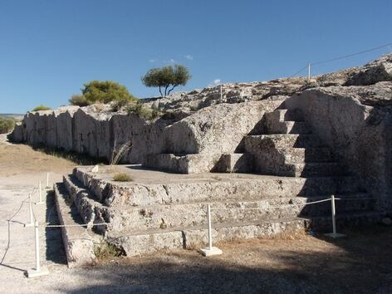

DEMOCRACY IS SIMILLAR TODAY

Slide 14
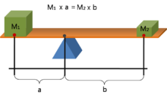
ARCHIMEDIES LEVERS
This is the law of the lever, which was proven by Archimedes using geometric reasoning. It shows that if the distance a from the fulcrum to where the input force is applied (point A) is greater than the distance b from fulcrum to where the output force is applied (point B), then the lever amplifies the input force

Slide 15
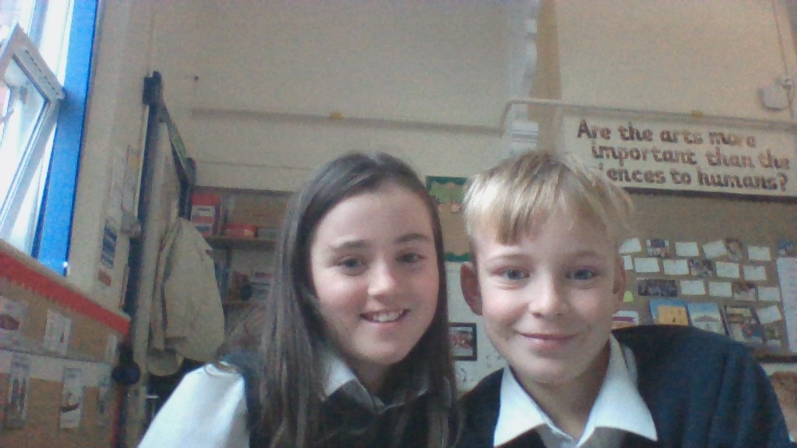
BY RU AND FLO

