Slide 1
Monday 22nd November
LO: How did the ancient Greeks influence life today?

Slide 2

Democracy
Democracy is a form of order and conduct between citizens of a country or place. The first democracy was in ancient Greece (508-507 BC) in Athens, Greece but compared to modern democracy it has changed rapidly between the years. Women, slaves, person of colour and foreigners were not allowed to vote. This is different to todays government.

Slide 3
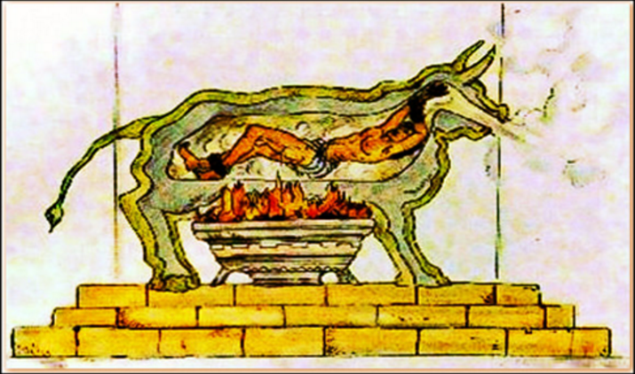
punishment
30,000 men had the right to speak however they only had until the jar of water ( which was used as a timer) was completely empty. Anyone who commit a crime wether it was a pity crime to a murder had their name written on a piece of pottery. If a persons name was written on the pottery 600 times they would be exiled and never allowed to return.

Slide 4
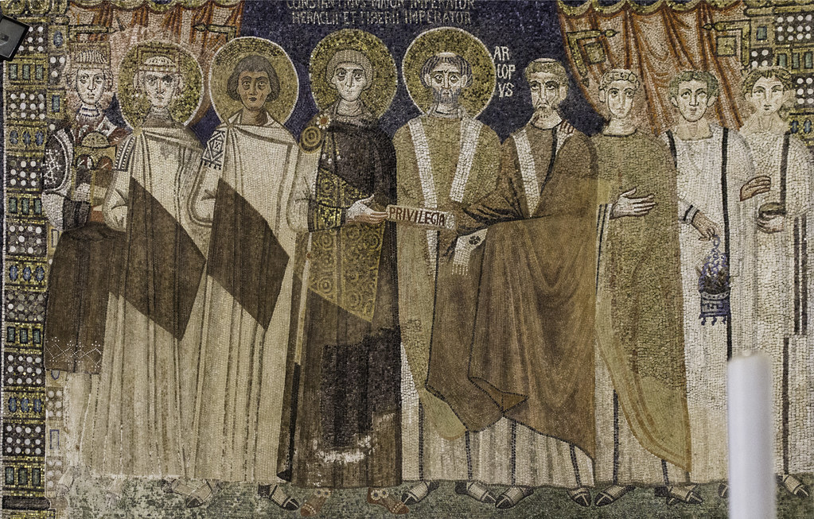
Ekklesia
The ekklesia was the main assemble of people who gather an estimate 40 times per year To make law and decision in Athens. Any male Athenian could attend the event out of 40,000 men only 5,000 men went regular. Women could not come this is different to day.

Slide 5
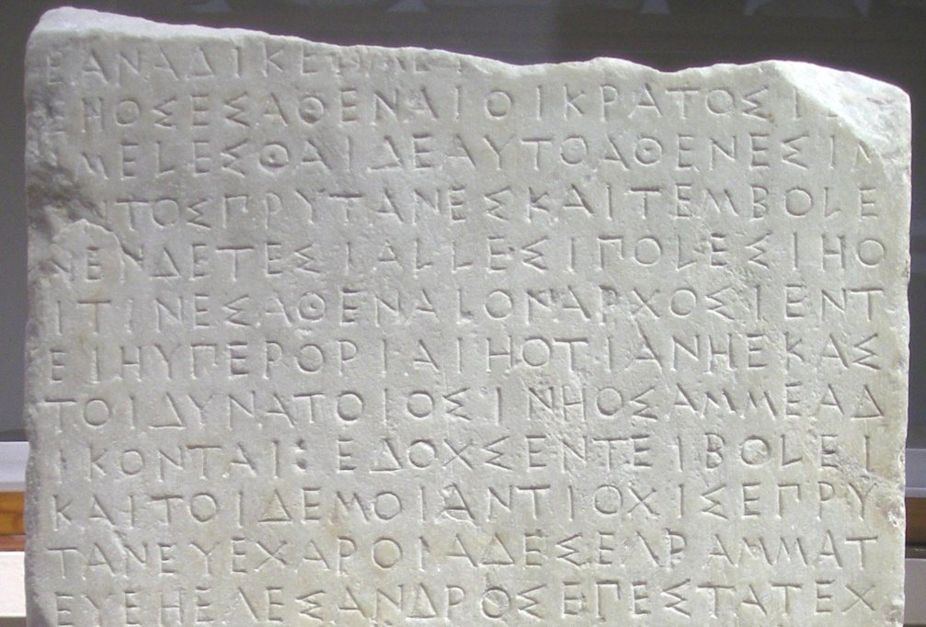
THE BOULE
The Boule were a group of 500 men who served for a 1 year at a time;They were chosen randomly. They talk about new laws in Athens, there like a jury in todays time.

Slide 6
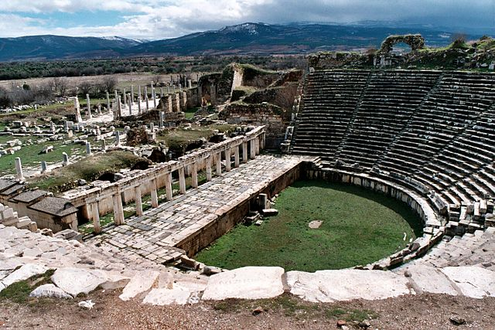
The Dikasteria
The Diskasteria (popular courts) were a group of 50,030+ jurors who dealt with crimes since there were no rules or police to discipline the criminals. Only men could be selected to be in the Diskasteria as woman did not have the right to.

Slide 7
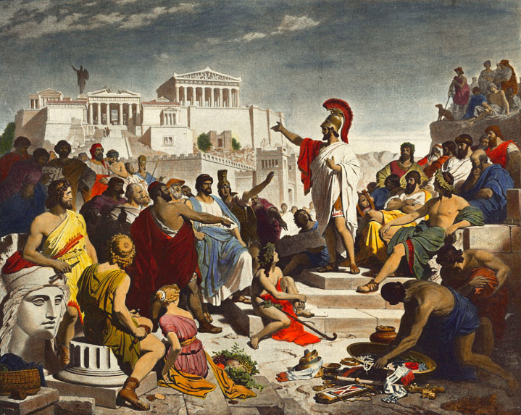
Fun Facts!
Democracy translates in ancient Greek to dēmakratia.
Athens began to use democracy around 500 BC.
In ancient Greece you had to be male and over 20 to vote.
Democracy began about 3,000 years ago

Slide 8
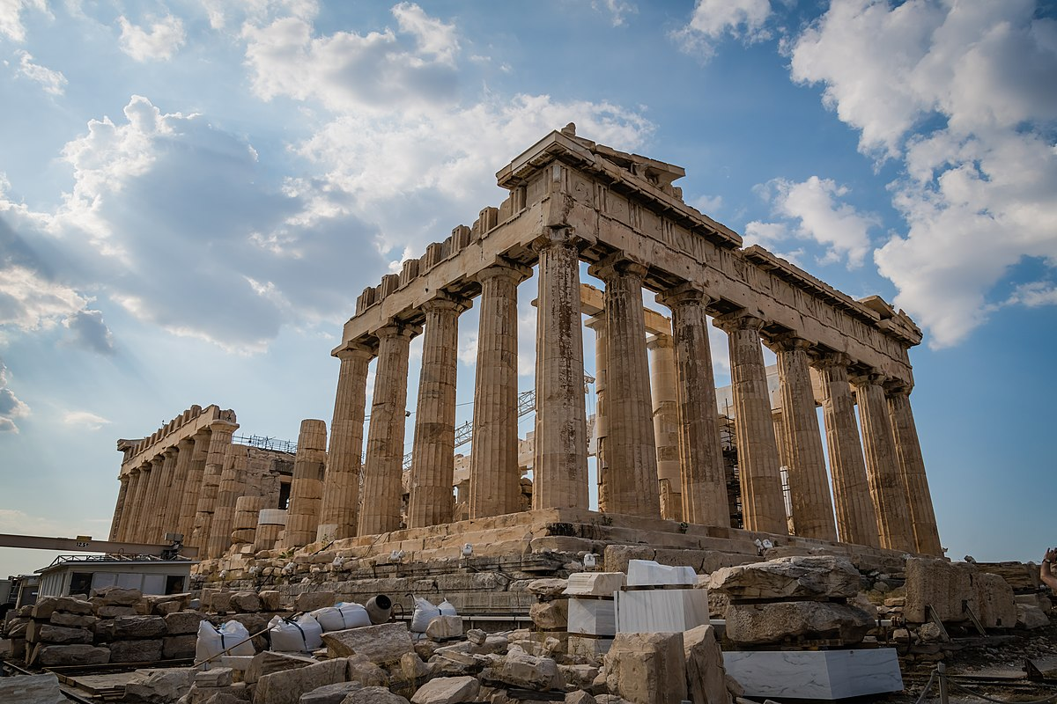

THE END

