Slide 1
Monday 22nd November
LO: How did the ancient Greeks influence life today?
By Nevaeh and Amelie

Slide 2
Democracy
.
.
In ancient Athens, citizens would gather together on a dusty hill called the Pnyx. Here they would decide the city’s laws and who should sit on its ruling council. This was ‘democracy’ or ‘rule by the people’. All 30,000 citizens were men. Women and enslaved people didn't get a say. A citizen could speak for the time it took water to run from one jar into another. When this water clock ran out, it was someone else’s turn.
A jury of 500 citizens decided if someone was guilty of law-breaking. Punishments included death. Citizens could also vote to get rid of people they disliked. Each man wrote a name on a broken bit of pottery called an ‘ostracon’. Anyone named more than 600 times got kicked out of the city. Today, we also live in a democracy. Unlike in ancient Greece, women get to vote, too. Juries of 12 people decide if someone is guilty of a crime - we don’t use ostracons anymore!

Slide 3
Democracy
l
Voting
At Ancient Athens, only men had the right to participate and vote. Slaves, kids and women are not allowed to vote. Men (twenty or over) were only allowed to participate, now women and men are allowed to participate and vote. People are now allowed to vote at the age of 18.

Slide 4
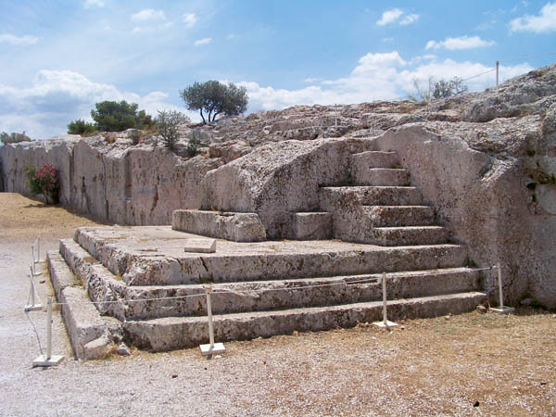
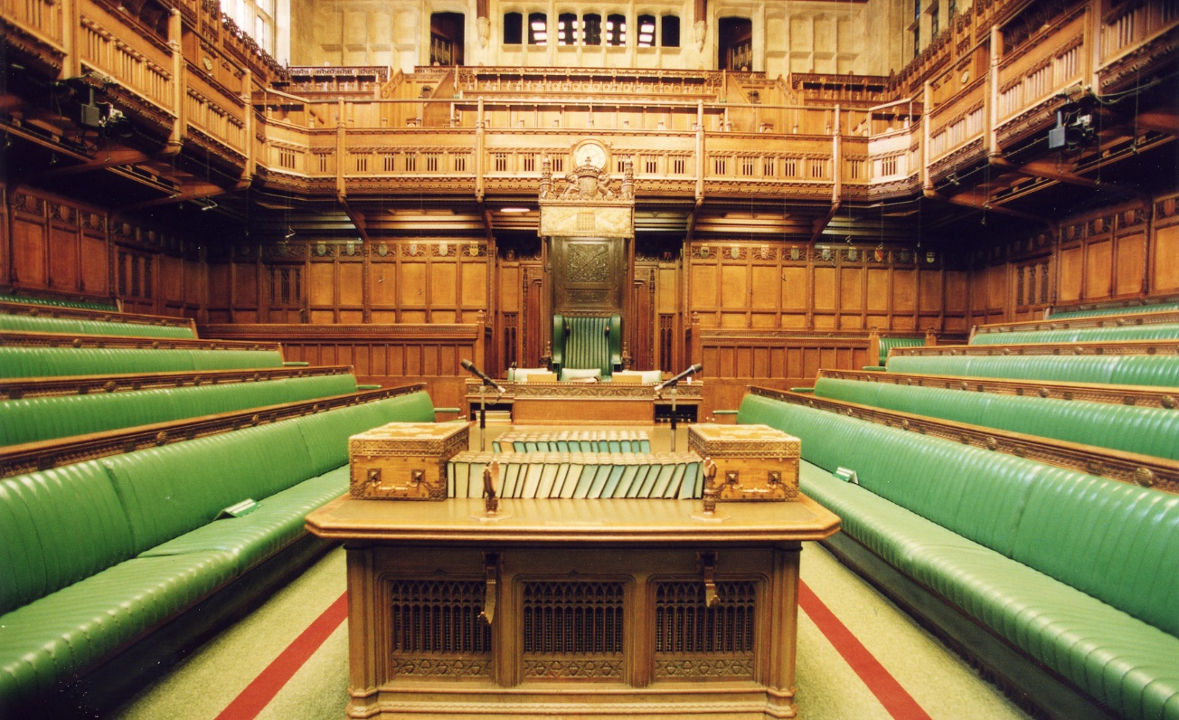
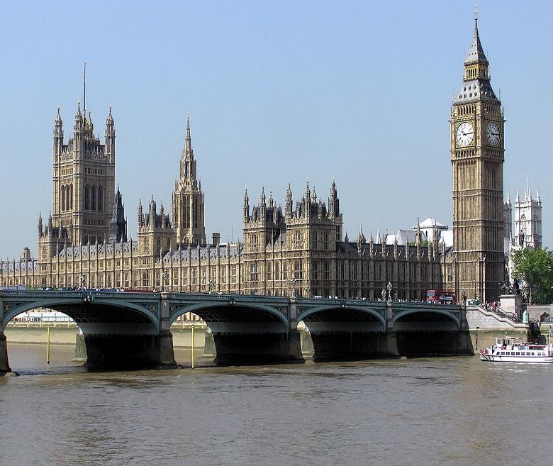
Greek Voting stand
HOUSE OF PARELIMENT

Slide 5
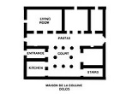
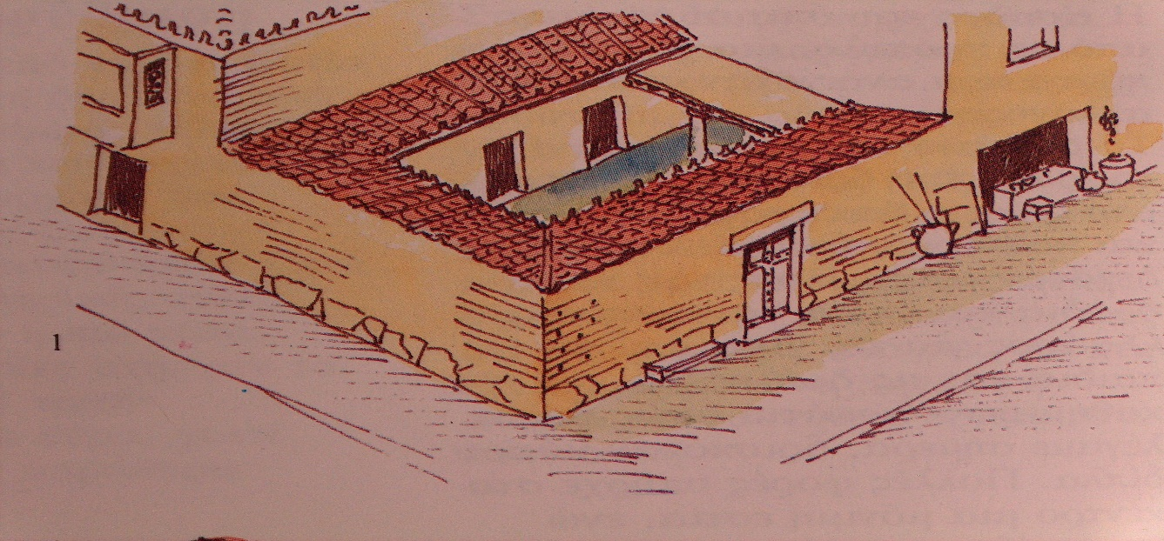
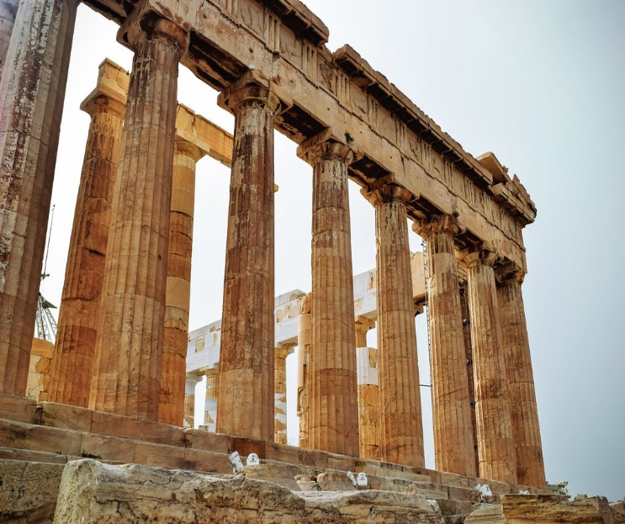
Greeks homes
This is an Ancient Greeks house blue print, living room , bed rooms , count yard and ladies room ONLY.

Slide 6
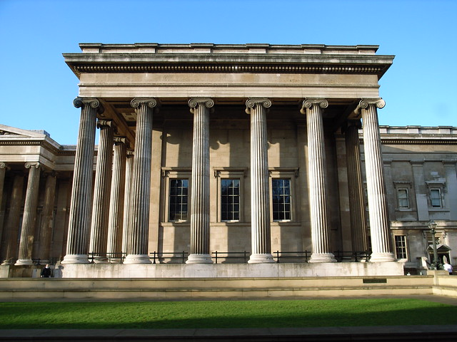
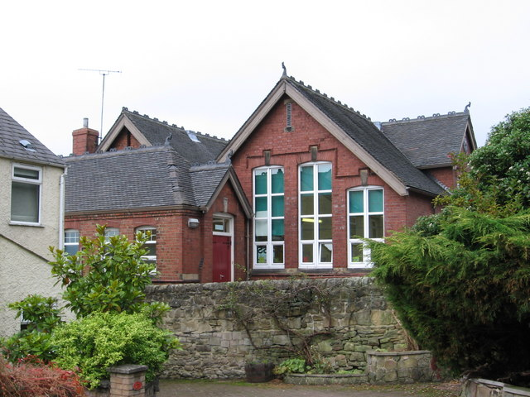
Ancient Greek schools
There Schools
Our School today

Slide 7
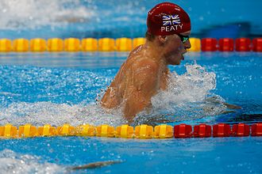
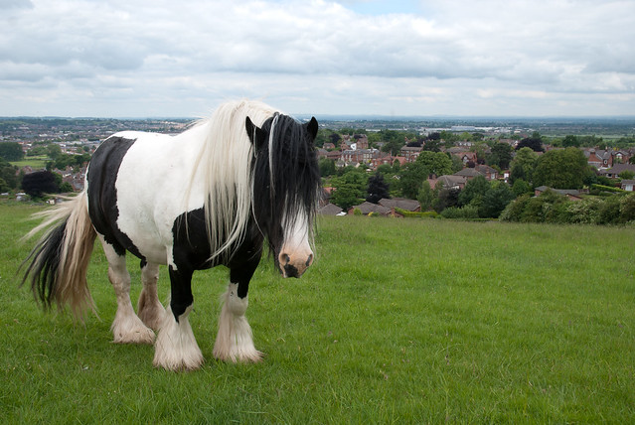
THE END
Made by Amelie and Nevaeh
=)
THANKS FOR LISTENING

