Slide 1
Monday 22nd November
LO: How did the ancient Greeks influence life today?

Slide 2
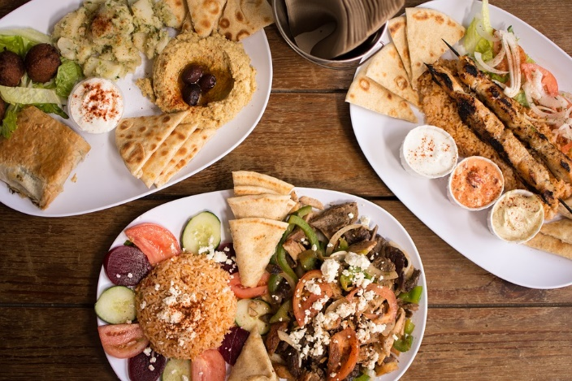
Food and pets
The ancient Greece lived around 3,500 years ago their legacy shapes the wild we live in today.For some people live in Greece was good and Many lived in busy towns and cities.
Finding a great meal in ancient Greece would have been very easy because they ate a lot of food.The Greeks loved their pets especially dogs.like most modern societies dogs were the most common pets in ancient Greece.

Slide 3
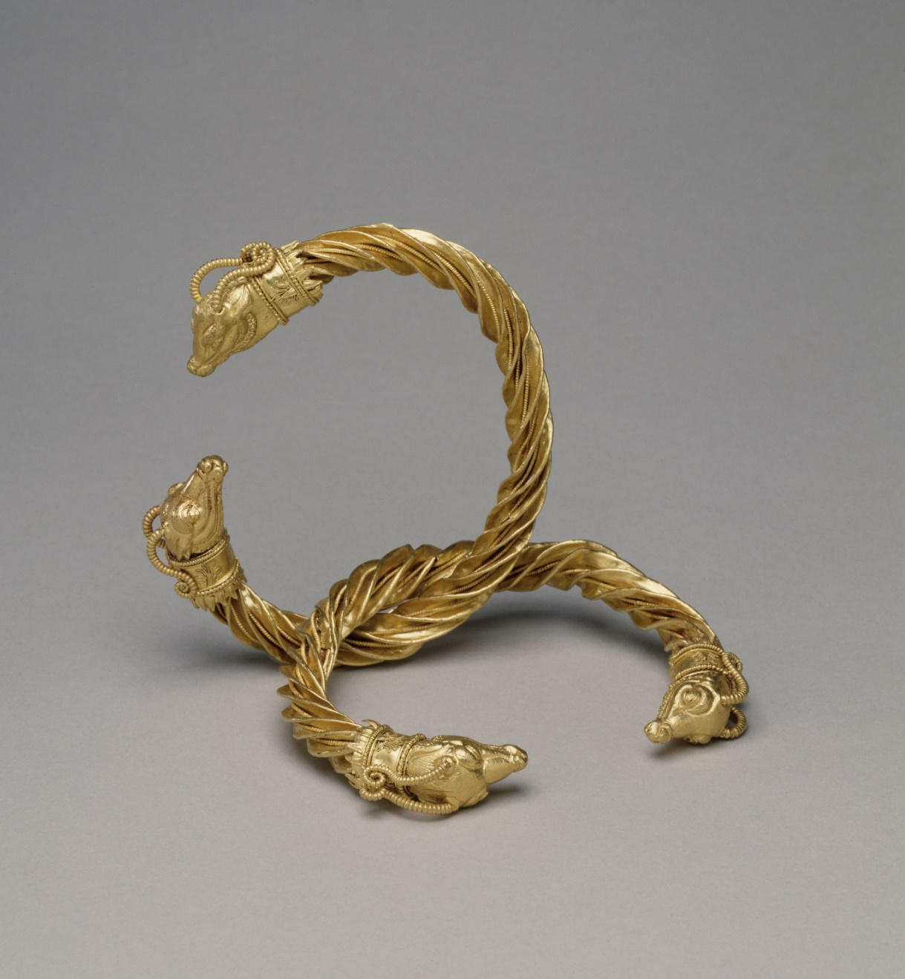
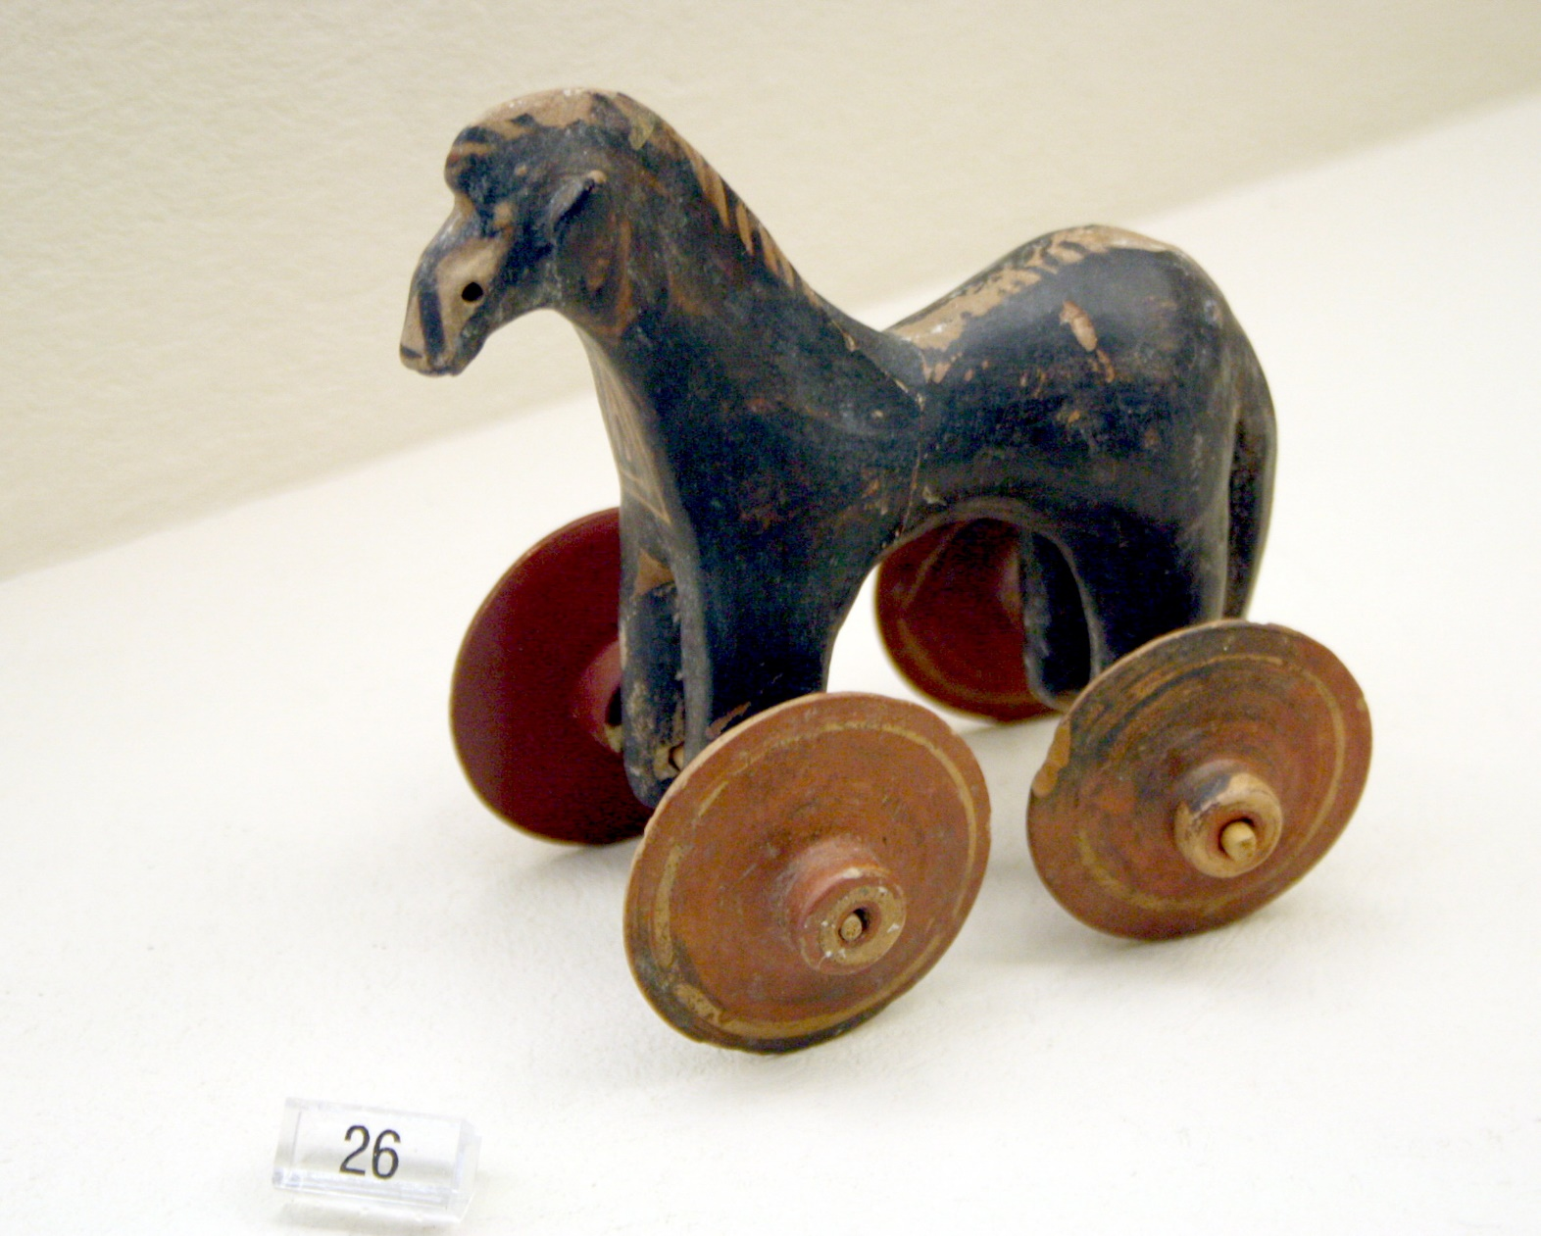
Children toys
Just like children today, children in ancient Greece loved to play with a variety of toys.

Slide 4
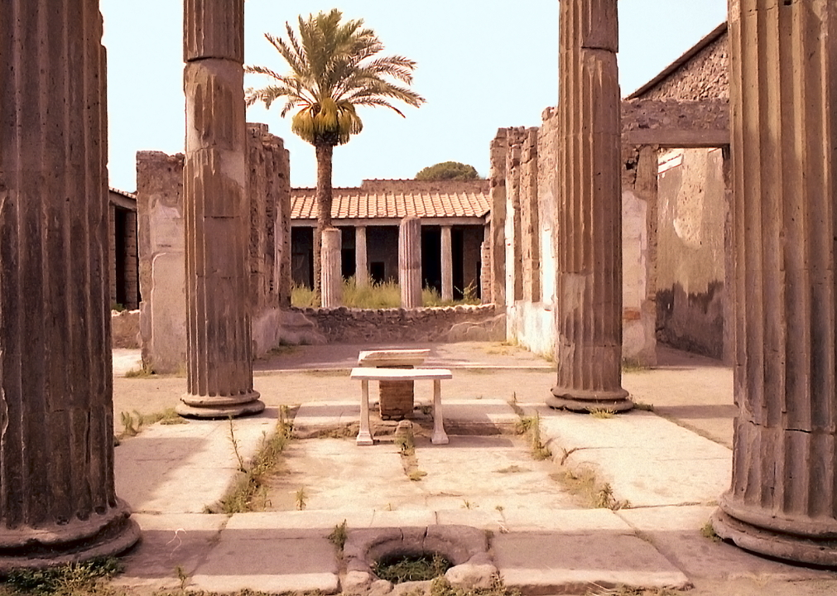
Houses
The architecture of greek houses in ancient times was designed to keep their residents cool

