Slide 1
Monday 22nd November
LO: How did the ancient Greeks influence life today?

Slide 2
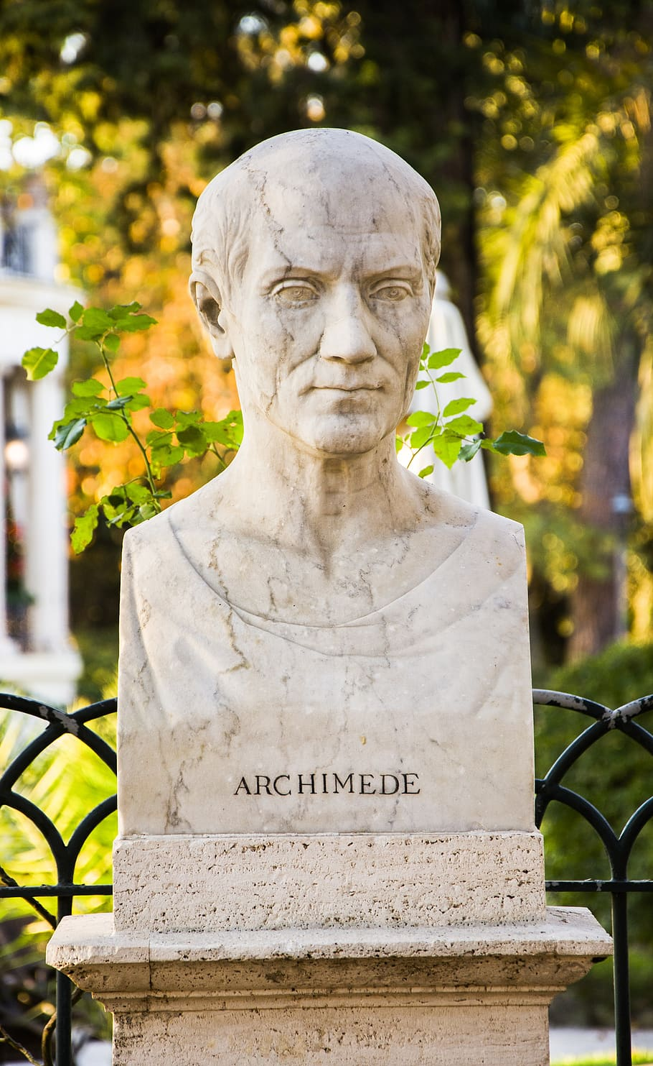
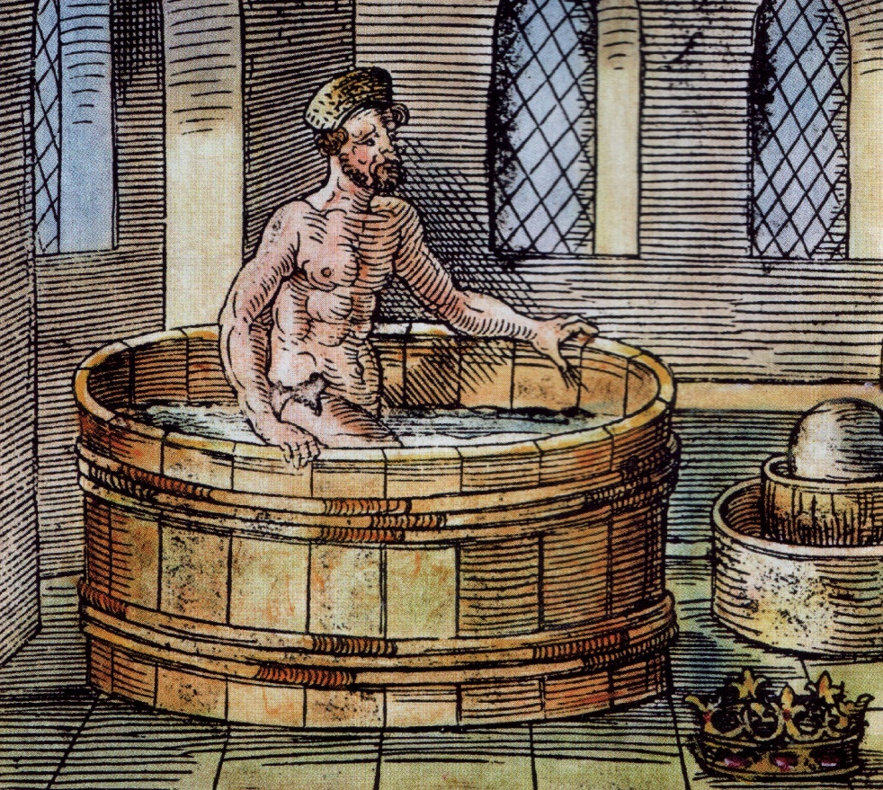
ARCHIMEDES

Slide 3
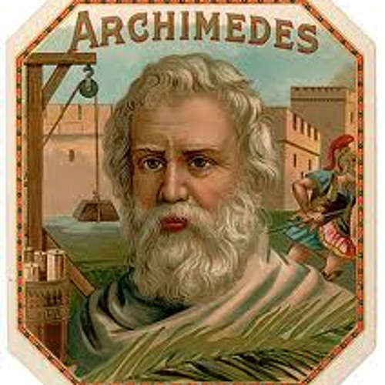
What did Archimedes do?
Archimedes a famous Greek philosopher had the brilliant idea of coming up Archimedes screw a form of positive-displacement pump. Archimedes was born in 287 BCE and died 212 BCE. Archimedes was relaxing in his bath when he apparently came up with a wonderful invention and ran down the street naked!

Slide 4
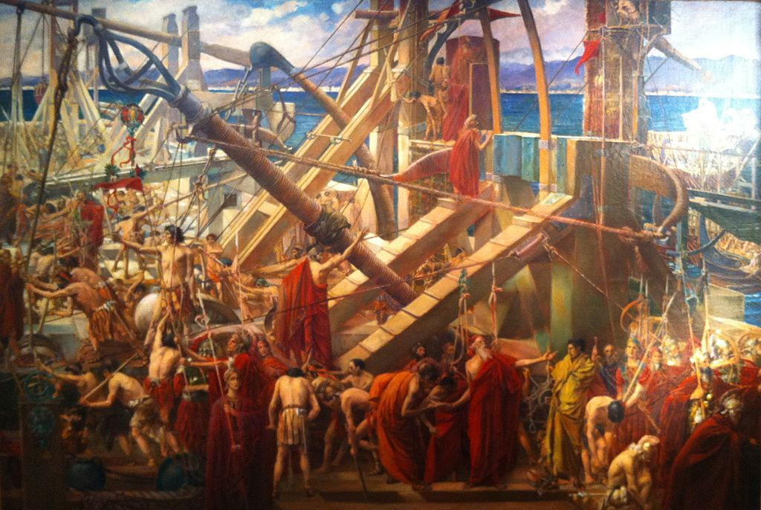
The Archimedes claw
The claw of Archimedes was a ancient Greek invention from Archimedes to defend seaward.

Slide 5
Archimedes Inventions
Cicero describes visiting the tomb of Archimedes, which was surmounted by a sphere, and a cylinder, which Archimedes had requested be placed on his tomb to represent his mathematical discoveries.

Slide 6
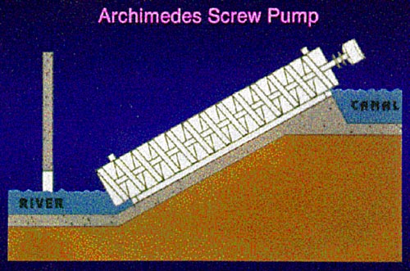
Archimedes’ Screw
A large part of Archimedes' work in engineering probably arose from fulfilling the needs of his home city of Syracuse. The Greek writer was commissioned to design a huge ship. The Syracuse, which could be used for luxury travel, carrying supplies, and as a naval warship.

Slide 7
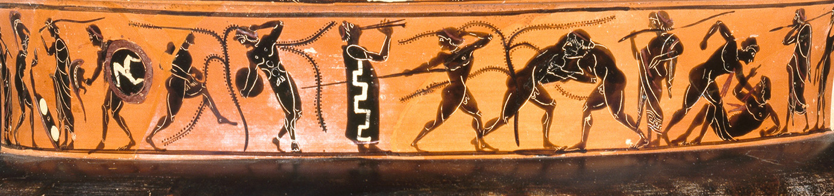
THE OLYMPICS
The Olympics is a spots festival that happens every 4 years. The games conclude on Sprinting, 3x3 Basketball, Acrobatic Gymnastics, Alpine Skiing ,Archery Artistic Gymnastics ,Artistic Swimming and so on. But what happened in the ancient Olympic games the games were different and not as safe like running, long jump, shot put, javelin, boxing, pankration and equestrian events.

