Slide 1
DEMOCRACY

Slide 2
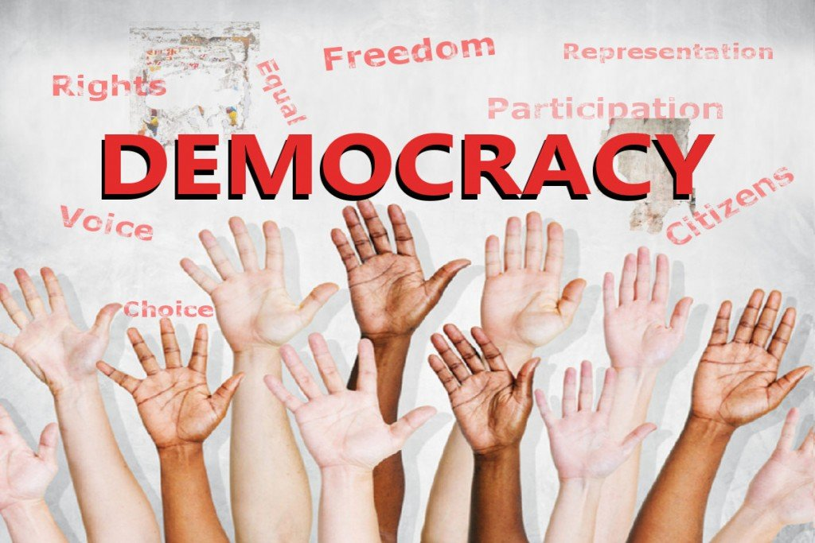
WHAT IS DEMOCRACY ?
Democracy is a fair political system where all adults vote for an elected government.

Slide 3
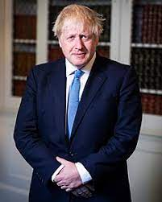
WHAT DOES IT MEAN IN THE UK TODAY ?
Adults in the UK vote in elections to choose a political party, MPs and the Prime Minister.

Slide 4
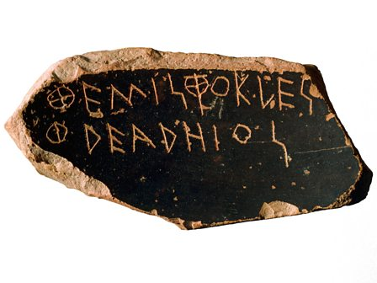
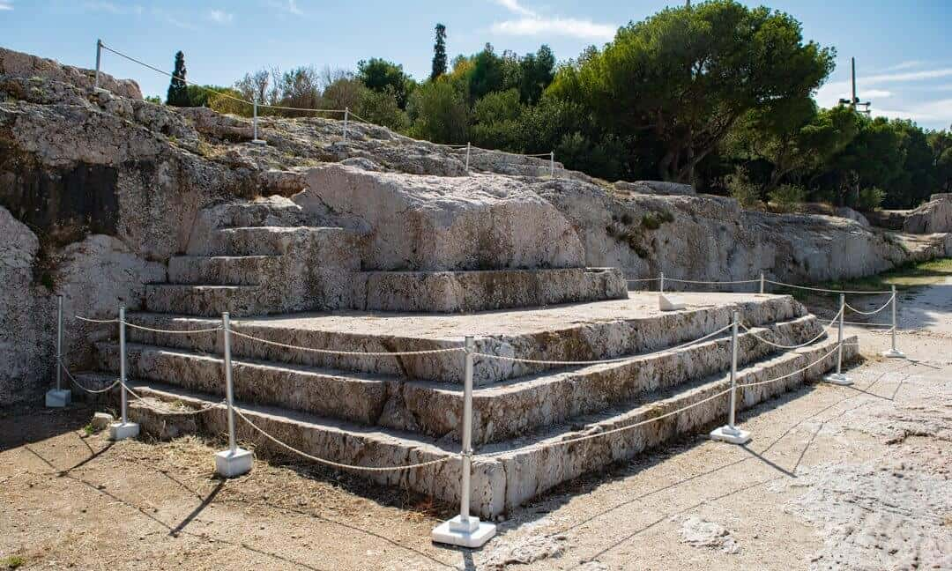
pnyx
In ancient Athens, citizens would gather together on a dusty hill called the Pnyx. Here they would decide the city’s laws and who should sit on its ruling council

Slide 5
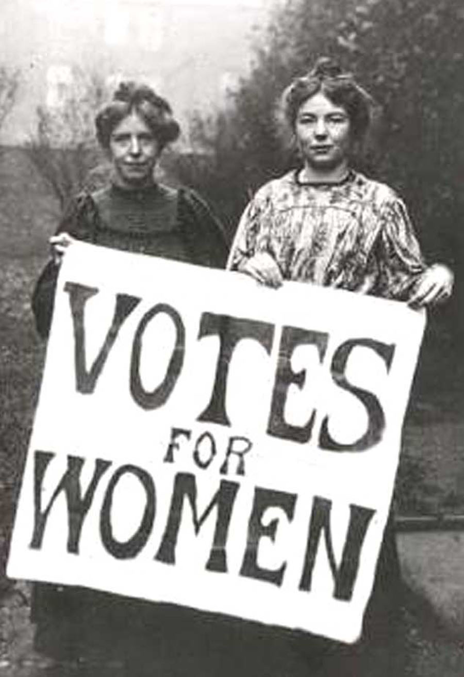
Today ,we also live in a democracy.
Unlike ancient greek women get to vote too.

