Slide 1

Monday 22nd November
LO: How did the ancient Greeks influence life today?

Slide 2

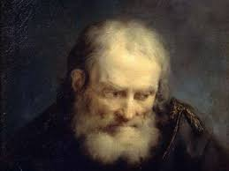
ARCHIMEDES
He was a Greek engineer and is most fame's for running down the street naked. He invented the heat ray. He lived to 287 BC to 212 BC. He was an inventor, philosopher, astronomer and mathematician!

Slide 3

Archimedes screw
Archimedes invented the screw in a chocklet fontine

