Slide 1
archimedes

Slide 2
LIFE
He was a brilliant mathematician who lived in Syrazcuse on the island of Sicily.
He also invented the Archimedes screw(next slide)

Slide 3
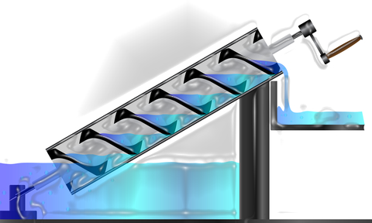
Archimedes incredible inventions
Archimedes screw is a uphill water transportation.
Is a positive-displacement pump that traps fluid from a source of water and the screw forces the water uphill.

Slide 4
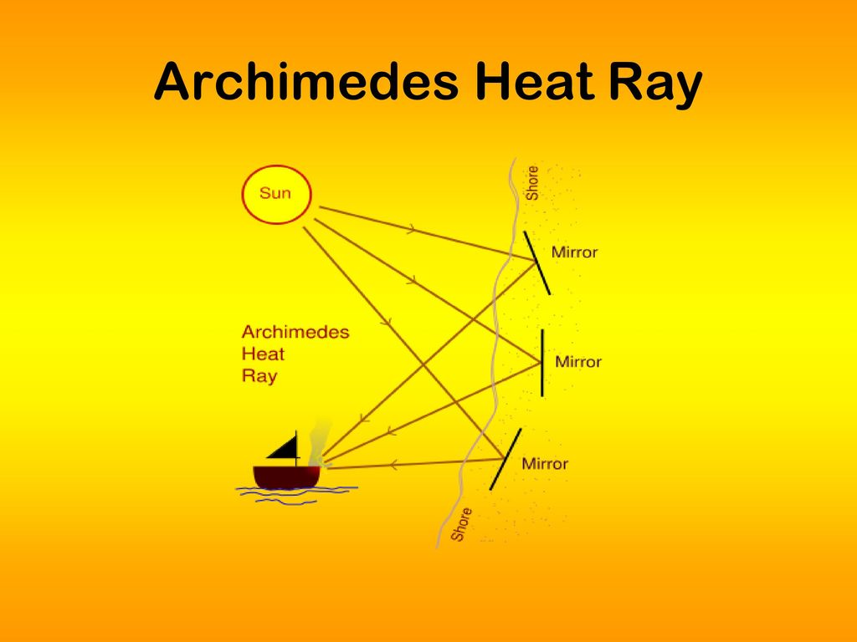
Archimedes incredible inventions jmhnuHeat ray
Archimedes' Death Ray worked by focusing the sun's rays using a series of mirrors. These polished, reflective mirrors were held by soldiers along the city's walls to ignite the boats.

Slide 5
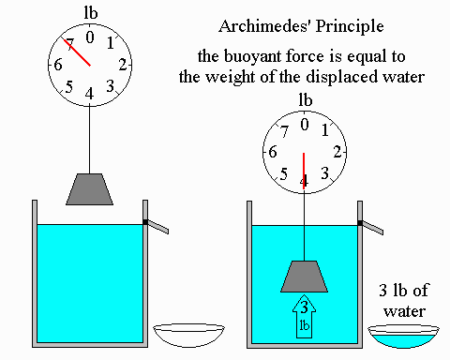
Archimedes principle

Slide 6
Credits
Brain-Charlie & Lucas
Pictures-google & paste
Spell check-computer
Lighting-computer battery
Audience-class 3 (humans)

