Slide 1
ARCHIMEDIES
Archimedes was born in 287 BC died in 212 BC. In a town in sedly in Syracuse and lived with his farther and mother until he was 10 years old.

Slide 2
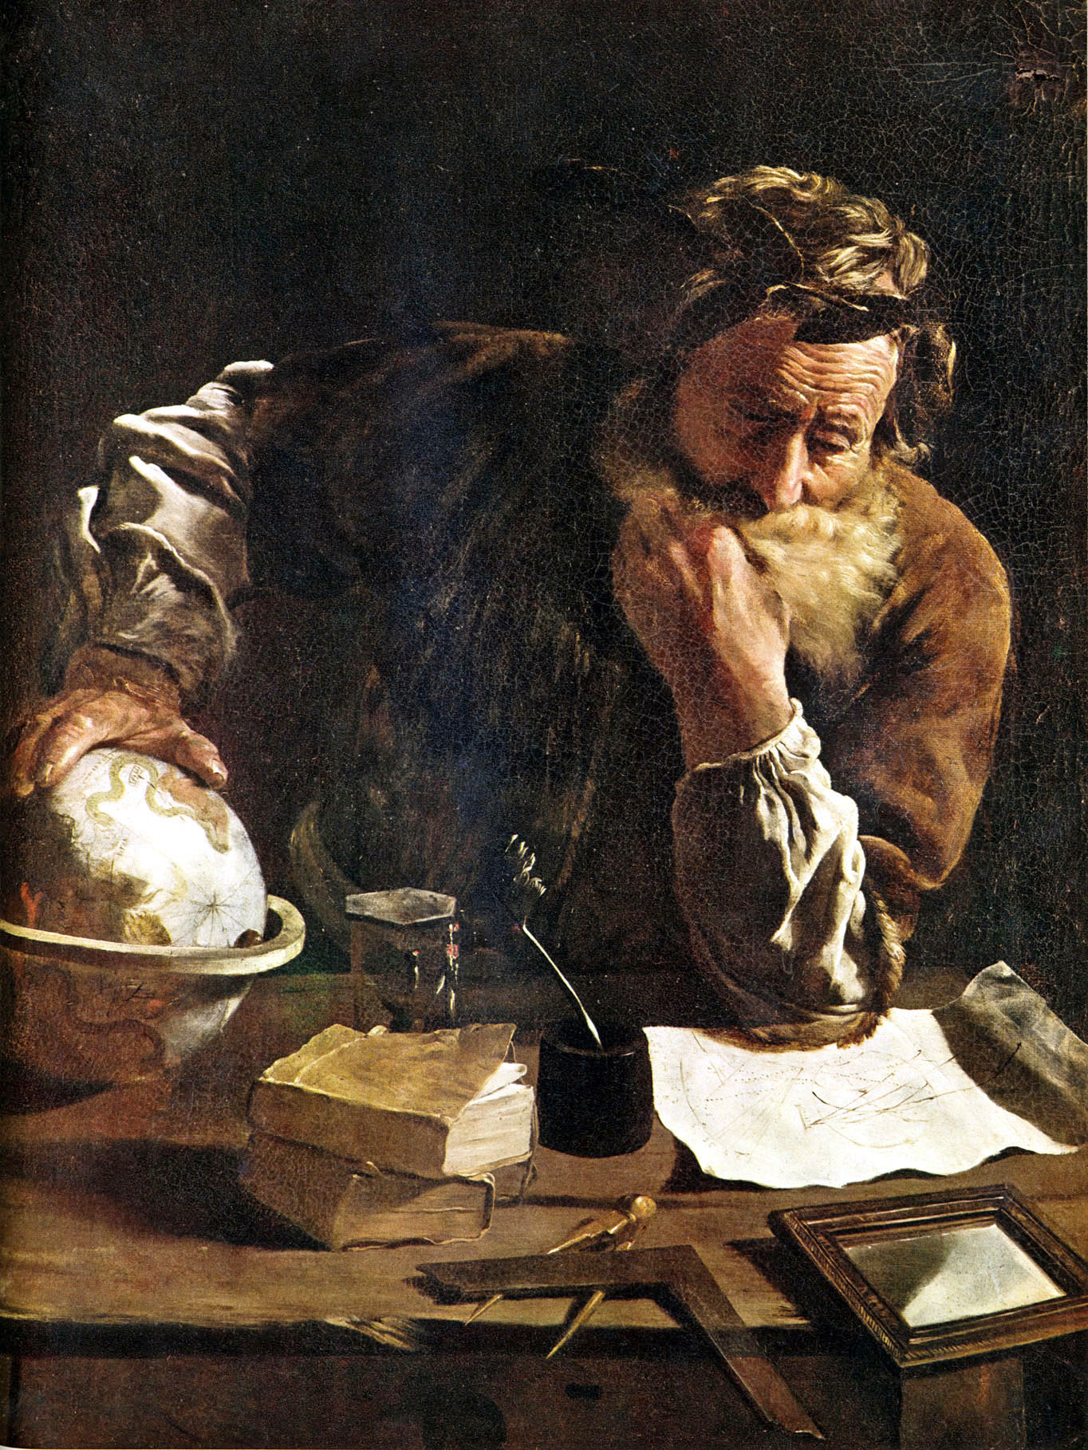
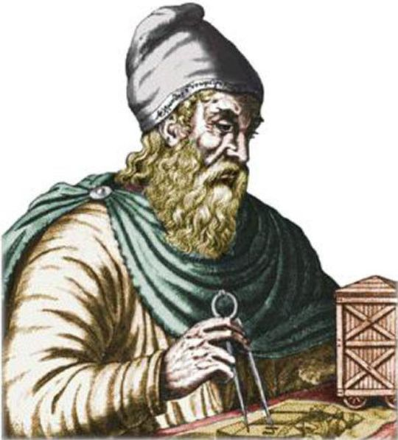
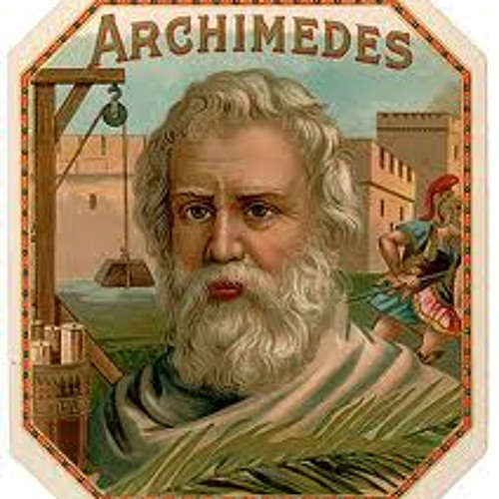
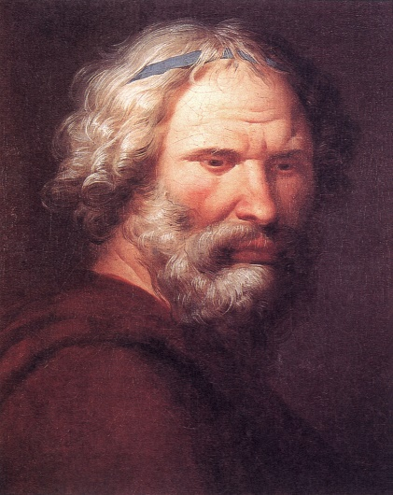
FAMILY LIFE
Archimedies’ dad was a astronomer and his name was Phidias. Since his dad was an astronomer he taut Archimedies everything he knew.

Slide 3
WHO WAS BETTER
ARCHIMEDES
PLATO
WON THE GREEKS THE WAR
INVENTED THE CATAPULT
RAN DOWN THE STREET NAKED
HE WAS A GREEK SOLDGER
HE GAVE EDUCATION TO CHILDREN
HE HAD A VEIW OF DEATH

Slide 4
GEOMITRY
When archimedes got older he realised that shapes and numbers had a huge part in life

