Slide 1
Monday 22nd November
LO: How did the ancient Greeks influence life today?

Slide 2
WHO COULD VOTE?
In order to vote, you had to be a citizen of Athens. However, not everyone who lived in Athens was a citizen. Only men who had completed their military training were counted as citizens.

Slide 3
TYPES OF GOVERMENT
There were three main types of government:
Democracy - A government ruled by the people, or assembly.
Officials and leaders were elected and all citizens had a say. Monarchy - A single ruler like a king. In Athens this ruler was called a Tyrant.
Oligarchy - When the government is ruled by a small group.

Slide 4
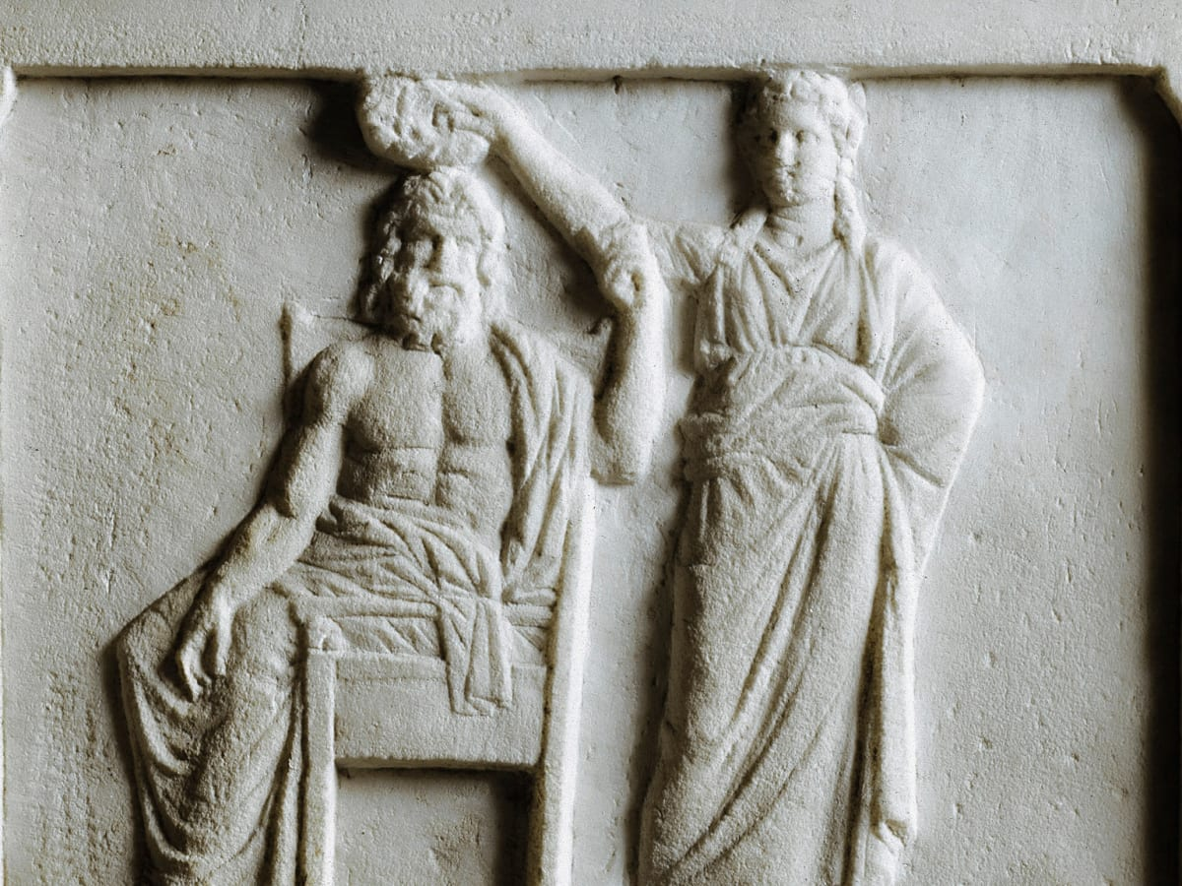
ATHENIAN DEMOCRACY
Democracy in Ancient Greece was very direct. What this means is that all the citizens voted on all the laws. Rather than vote for representatives, like we do, each citizen was expected to vote for every law.

Slide 5
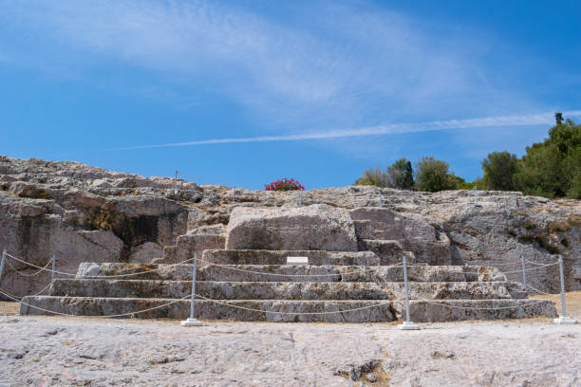
THE EKKLESIA
Only male citizens could attend to the pnyx.This is a picture of a broken pnyx.It was built in ancent Greece.

Slide 6
Similarities today
One similarity is we still have Olympics' games today.
We also do 26 miles in our marathon's which originally came from ancient Greece.
And we also have temples and mosaic's.
Some buildings in the UK have pillars like ancient Greek temples.

