Slide 1
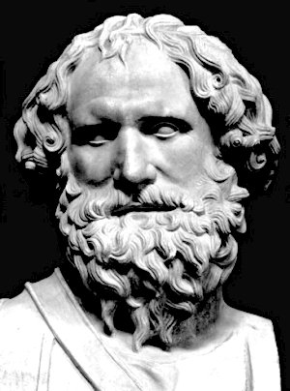
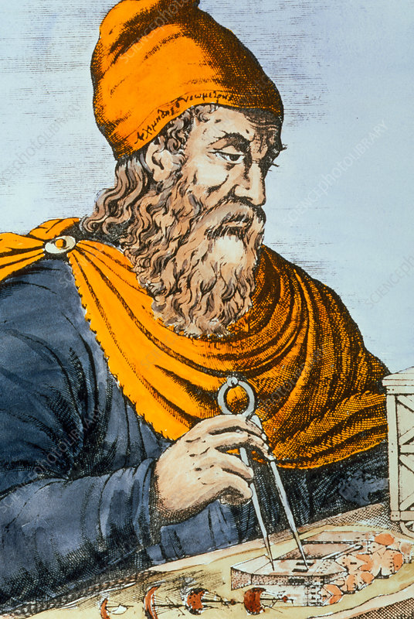
Archimedes

Slide 2
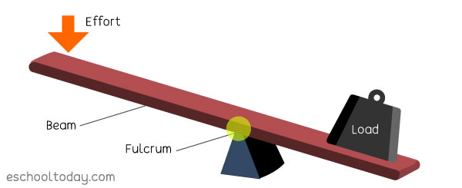
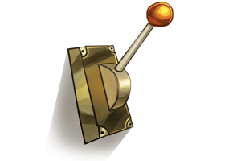
Facts on the lever
A lever is a simple machine. It is something that can be used in a lot of ways. One way is by measuring things, or by seeing which weighs more. A lever is supported by a fulcrum which it uses to lifts weights. It is one of six simple machines.

Slide 3
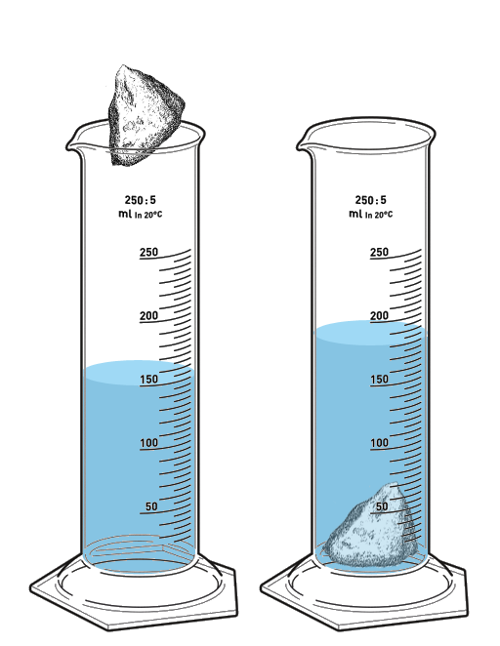
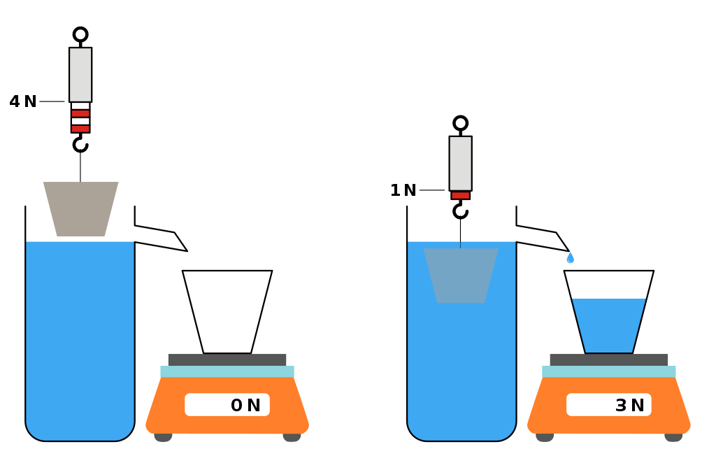
Archimedes principle
Archimedes principle is named after Archimedes of Syracuse the first to discover this law. When he did he ran naked out of his bathtub. Archimedes law is were you use water to discover the mass of the item.

Slide 4
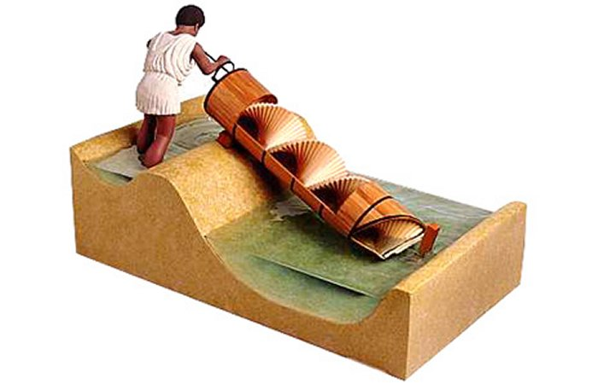
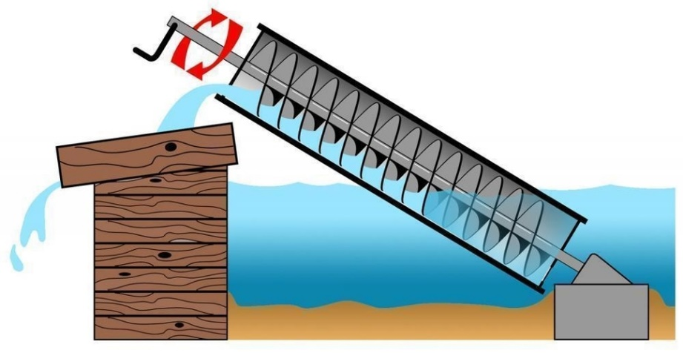
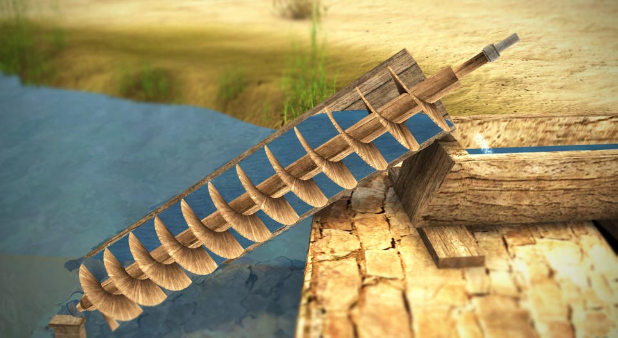
Archimedes Screw
Archimedes screw lifts water through a little compartment that then spills through the top of the contraption.

Slide 5
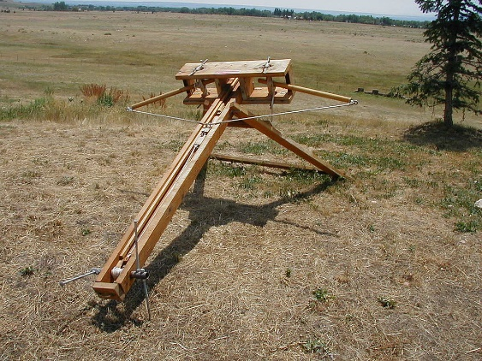
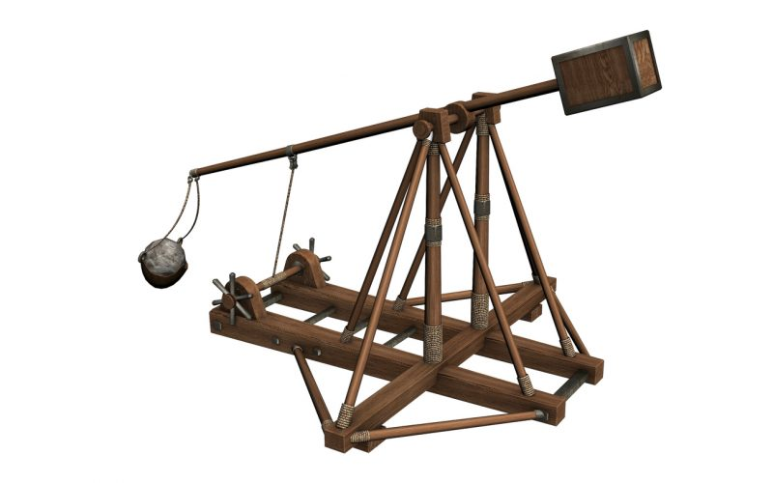
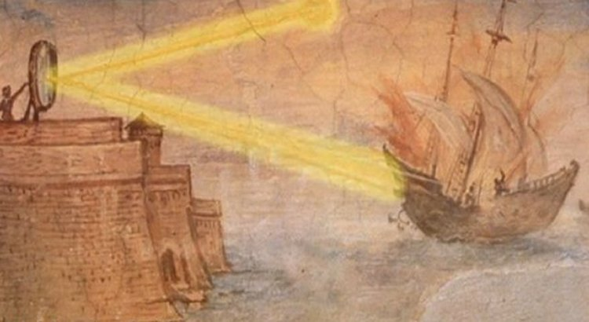
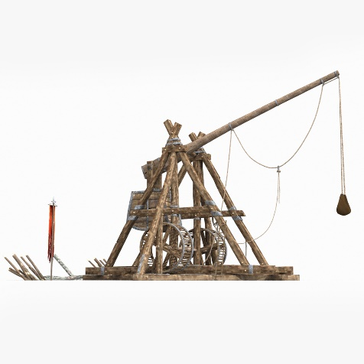
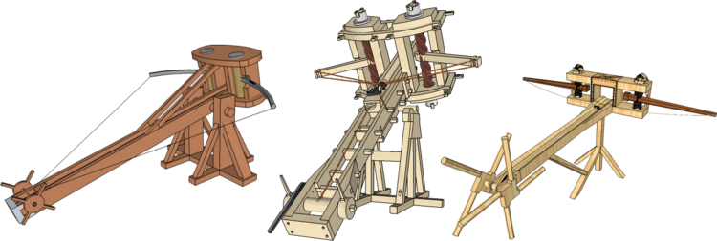
Archimede’s Weapons
Archimedes invented lots of war machines like sun rays , claws and cranes to attack enemy ships and ballistic things like ballista and catapults

Slide 6
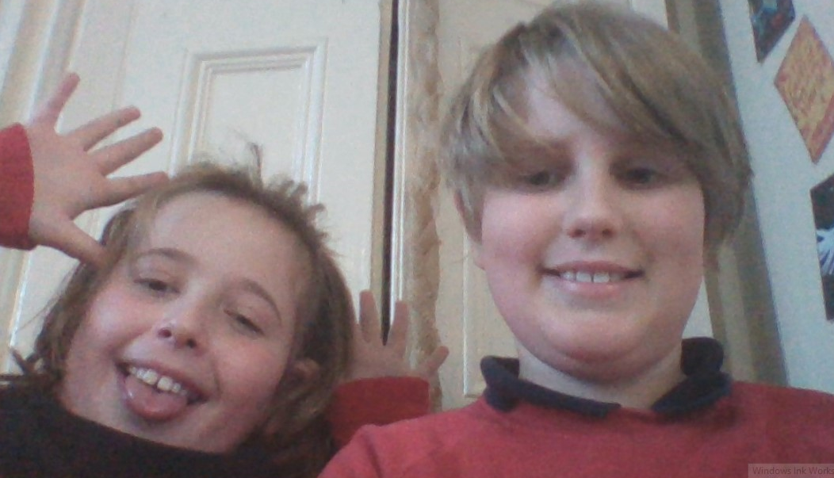
BYE THANKS!!!!!!!!!!

